Slide 1
Gameplay Analysis through
State Projection
Erik Andersen¹, Yun-En Liu¹, Ethan Apter¹, François Boucher-Genesse², Zoran Popović¹
¹ Center for Game Science
Department of Computer Science
University of Washington
² Department of Education
Université du Québec à Montréal
FDG 2010 June 21st, 2010
Notes:
Hello, my name is Erik Andersen from the University of Washington and I will be presenting this work with my co-author, Yun-En Liu.

Slide 2
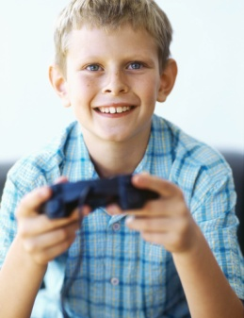




We want to know how people play
Notes:
It is important for us as game designers

Slide 3
We want to know how people play
Notes:
to gather data about how people interact with a game because we want to translate the experiences of the players into meaningful conclusions about how to improve the game.

Slide 4
We want to know how people play
?
Notes:
However, it can be difficult to know what to do with this data because games often have interaction patterns that are complex. This is particularly important for Games with a Purpose or educational games where we also want to evaluate whether or not the “purpose” of the game is being achieved.

Slide 5
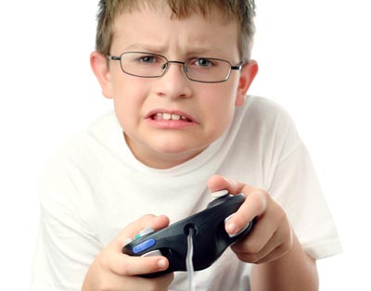
We want to find…
Notes:
As we have just heard from Michael John, many game designers have started to log data, but ideally, we want a general framework,

Slide 6
We want to find…
Player confusion
Notes:
that can uncover when the player is confused about game mechanics,

Slide 7
We want to find…
Player confusion
Player strategies
Notes:
identify key player strategies,

Slide 8
We want to find…
Player confusion
Player strategies
Design flaws
Notes:
and points of the game that commonly lead to failure.

Slide 9
Patterns in data
SELECT * FROM replays WHERE location=x AND time>y AND attempt>3 AND death=“grenade”…
Notes:
Ideally, we want to find patterns without specifically asking questions about the data, both because queries may be difficult to formulate,

Slide 10
Patterns in data
SELECT * FROM replays WHERE location=x AND time>y AND attempt>3 AND death=“grenade”…
Confusion? Strategies?
Notes:
and because we simply may not know what queries to ask in order to find complex patterns. We want a method where the game designer can just look at the data and find interesting patterns.

Slide 11
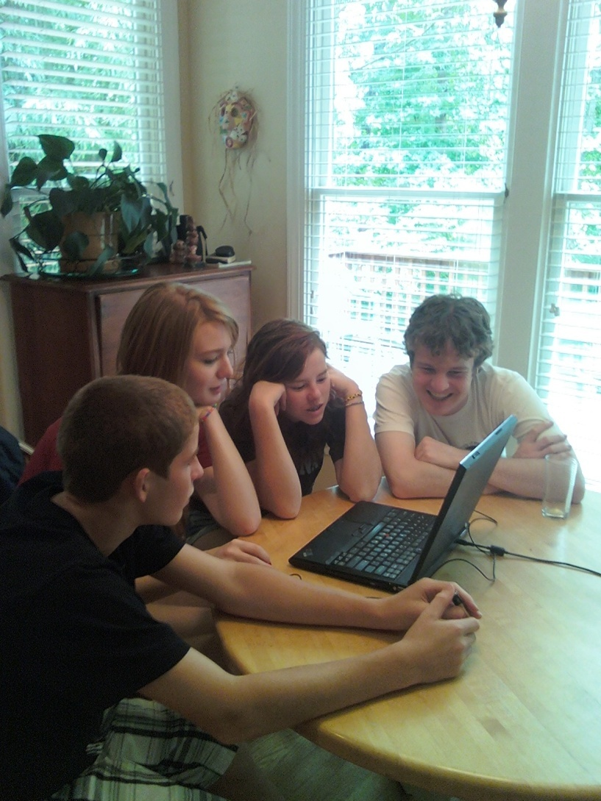
Traditional Playtesting
Notes:
Traditional playtesting centers around three basic techniques: direct observation, think alouds, and question-and-answer sessions. These methods are useful for detecting major flaws, especially early on in the process. However, they are less useful when whenever we want a more nuanced and statistically-motivated evaluation.

Slide 12
Statistical Methods
Surveys
In-game statistics
Notes:
To bring more of a data-driven approach to analyzing gameplay data, many designers have started applying statistical techniques as well.

Slide 13
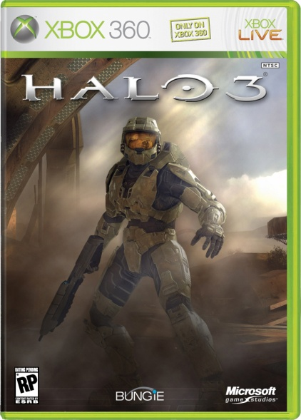
Statistical Methods
Surveys
In-game statistics
Notes:
For example, Microsoft Game Labs worked with Bungie to determine why players died in Halo 3. These methods are more empirical and can aggregate data from many players.

Slide 14
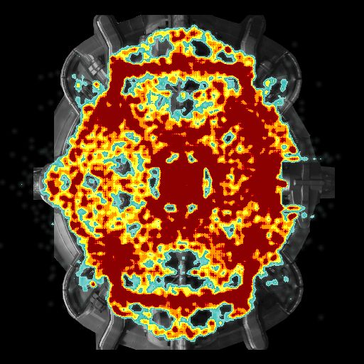
Visual Data Mining
Lets people see patterns in data
Bungie (Halo 3)
Notes:
Visual data mining is particularly good when you don’t know what patterns you are going to find, which often happens in games. For example, this is a heat map in Halo 3 that shows where players died in a particular level. We learned earlier in this conference about all the cool visualizations that Microsoft Game Labs has used. For a game like this that has a fixed virtual environment, heat maps are great because you can just overlay the data onto the level and understand the context for each data point.

Slide 15
Visual Data Mining
Lets people see patterns in data
Dynamic information?
Bungie (Halo 3)
Notes:
But what if we want to see how players move in general?

Slide 16
Visual Data Mining
Lets people see patterns in data
Dynamic information?
Games with no map?
Bungie (Halo 3)
Notes:
What about all the games that don’t have any map at all?

Slide 17
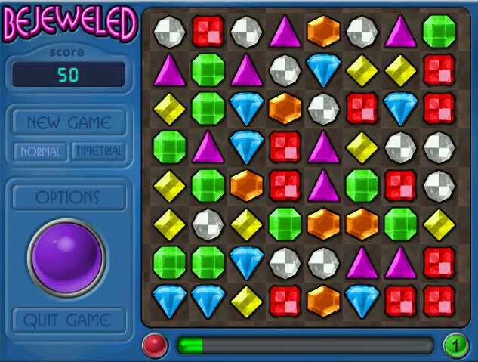
But what about?
Notes:
For example, it is not clear how to use a heat map on a puzzle game like Bejeweled,

Slide 18
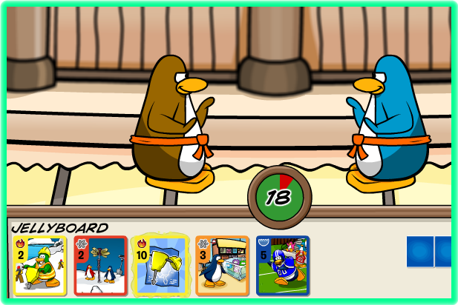
But what about?
Notes:
or in a card game like Card-Jitsu from Club Penguin.

Slide 19
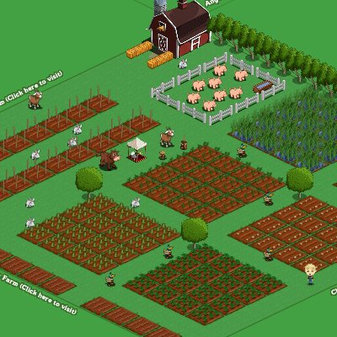
But what about?
Notes:
Farmville has a virtual environment but it keeps changing depending on what the player is doing.

Slide 20

But what about?
Notes:
Also, it hard to use a heat map for any game that has pieces, like Checkers. So, in this work, we aim to develop a general visual framework that works on all games with a concept of state.

Slide 21
“Playtraces”
Start
Goal
Notes:
In order to generalize to a larger field of games, it would be ideal to be able to see HOW players play the game, and to be able to visualize their trajectories through the game. For example, think of a playtrace as a graph where vertices are game states. There could be a start state and one or more goal states,

Slide 22
“Playtraces”
Start
Goal
Notes:
as well as all the other game states that we observe players in,

Slide 23
“Playtraces”
Start
Goal
Notes:
and the paths they take between states as they try to succeed.

Slide 24
“Playtraces”
Start
Goal
Confusion?
Distance to goal
Notes:
Even better, if we can draw the graph such that states that are far away from the goal state in the game appear far away in the visualization, and vice versa, we can just glance at the graph and see what strategies the players are trying. This is the key idea behind our Playtracer framework for gameplay analysis. Yun-En will now introduce Playtracer and the game we tested it on.

Slide 25
Refraction
Notes:
Let’s begin with the game, Refraction.

Slide 26



Refraction
Massive educational data mining
Notes:
Refraction is part of a larger effort at Center for Game Science at the University of Washington. Beyond just using telemetry to analyze our games, we want to use games to discover optimal pathways for understanding early math concepts. To do this, we will run randomized trials in our games by varying level progressions and game parameters for different players.
This will give us a lot of data from many games, so we need a fast, effective way to extract important patterns from this data.
<DEMO>

Slide 27
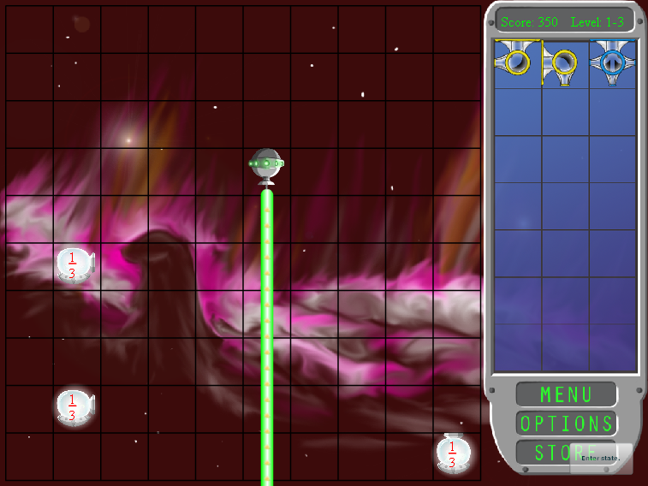
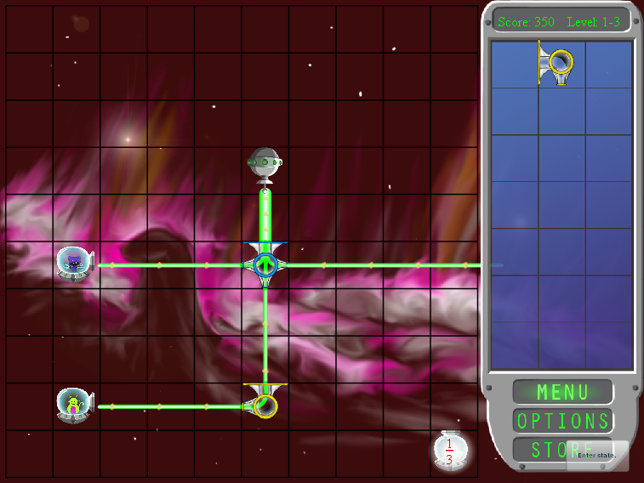
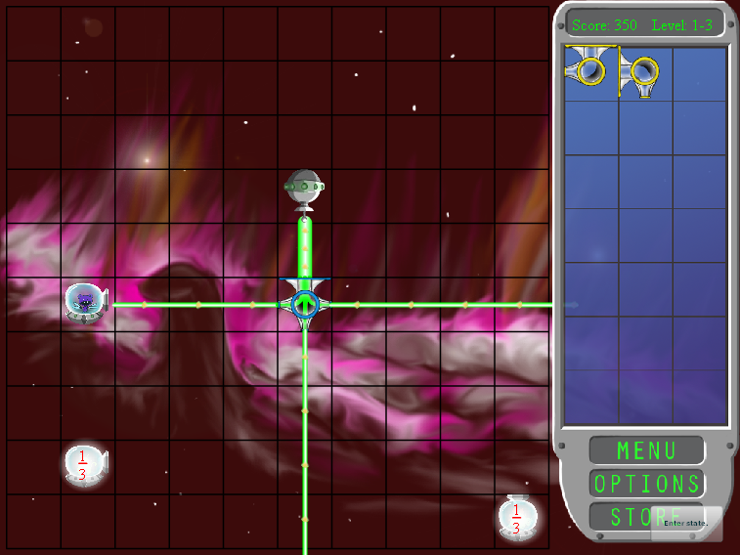
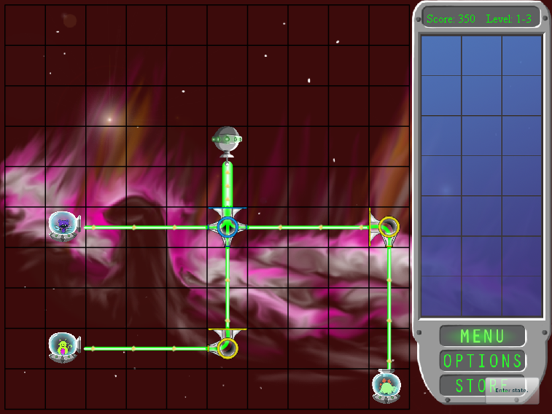
Notes:
I just made several moves in the game, resulting in the game boards shown in these four images. For the purposes of this talk, each distinct game board will be a state of the game and appear as a different node in our play graphs.

Slide 28
Notes:
By representing the game in this way, we can now produce visualizations that give some sense of movement through a level. In all our visualizations,

Slide 29
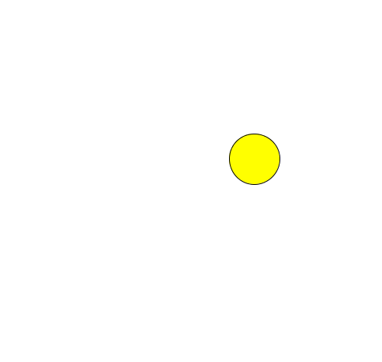
Notes:
Start states will be yellow,

Slide 30
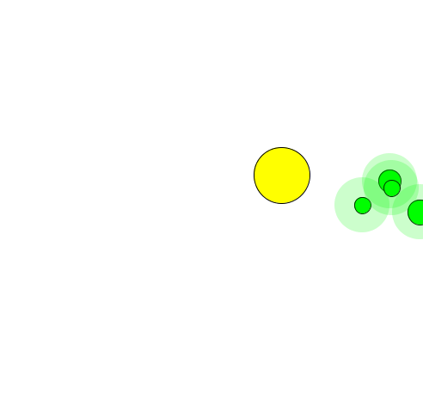
Notes:
Goal states will be green,

Slide 31
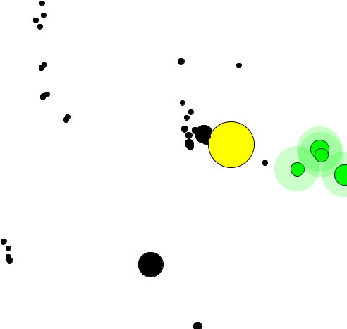
Notes:
And other observed game states will be black, with the state’s size being proportional to the number of players visiting it.

Slide 32
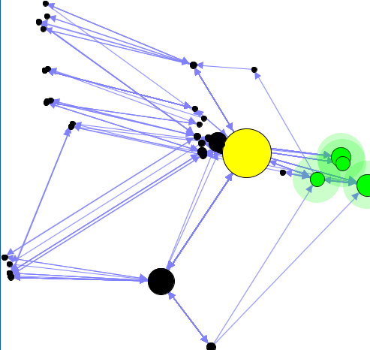
Notes:
Finally, transitions between states are represented as arrows.
Ideally, we can draw these graphs in a way that allows designers to identify areas of interest that can be explored further. If we can accomplish this in a general way, we will have a framework for gameplay analysis that functions on any game with a concept of state and player transitions between states.

Slide 33
Classic Multidimensional Scaling
2-D projection of points in high-dimensional space
Clusters game states based on some distance function
Notes:
Given a player graph, how do we best visualize it?
Our solution is to define a distance metric between states, and then perform multidimensional scaling on the state vertices. MDS will compress the data down into two dimensions while trying to preserve interstate distances.

Slide 34
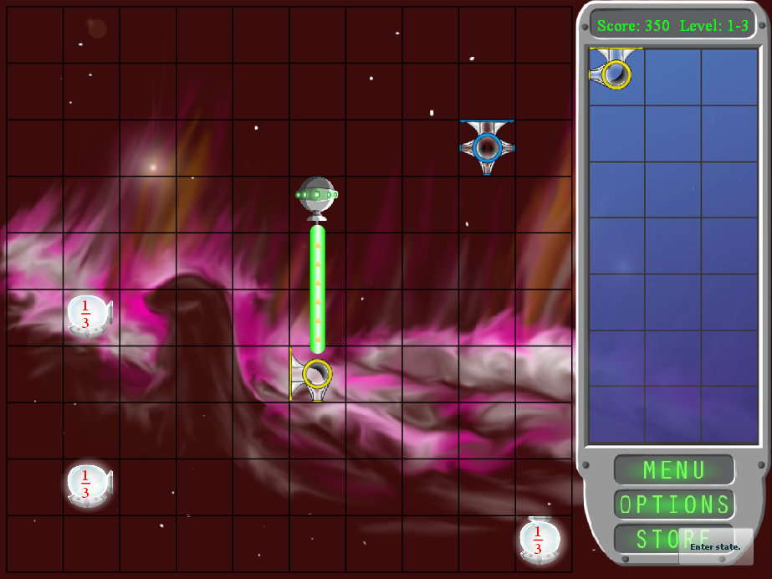
State Distance
Notes:
What characteristics should the distance metric have?
Well, let’s think of an example. In the state on the left, the player is using a piece to split the laser into necessary components.

Slide 35
State Distance
Notes:
While in the state on the right, the player has placed that splitter piece somewhere else entirely and replaced it with a piece that can’t even accept the laser from above. We would expect these states to appear far apart in the visualization.

Slide 36
State Distance
Notes:
On the other hand, let’s look at these two states. Again, in the state on the left the player has placed a splitter in the path of the laser.

Slide 37
State Distance
Notes:
Whereas in the state on the right, the splitter is in the same place and the player has bent one of the resulting lasers to satisfy a spaceship.
We would expect these states to appear close together because they are only one move apart.

Slide 38
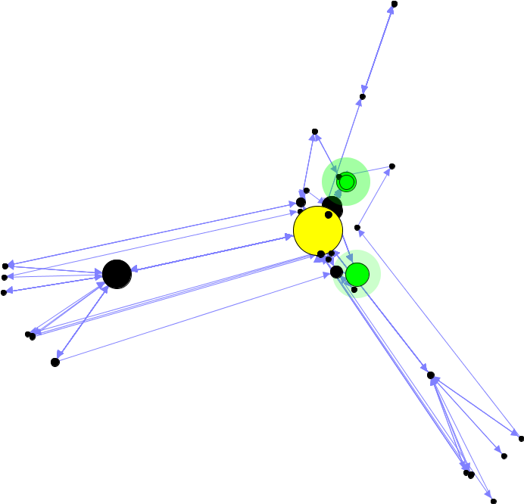
Action Distance
d_{a} (s₁, s₂)
Notes:
One natural idea here is to make the distance between states be the number of game actions necessary to convert one state into another. In our game, an action is putting down a piece or picking up a piece. This is the graph we get when using the action distance as our metric. The three spokes correspond to states that share certain pieces on the board in common, which causes them to cluster together.
Unfortunately, this graph is a hard to interpret. What’s going on in the cluster of states on the left hand side? What paths are players taking to the goals? It’s not really clear.

Slide 39
State Distance
Start
Goal
Confusion?
Distance to goal
Notes:
Our distance metric clearly needs more work. Upon further reflection, however, another desirable property that we would like to have is for states to align themselves so that we can see movement towards the goal and away from goal states.

Slide 40
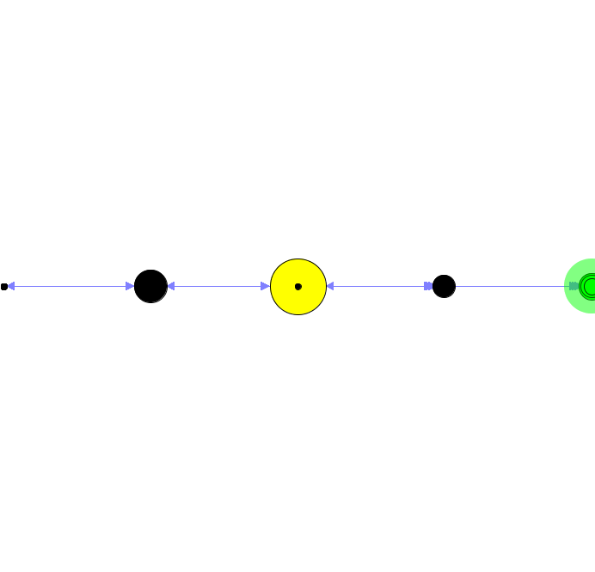
Distance to Goal
d_{g} (s₁, s₂) = abs(d_{g} (s₁, s_{g}) - d_{g} (s₂, s_{g}))
Notes:
We can achieve this by using the distance to the goal as a distance metric by making the distance between states the difference in the number of steps it would take to reach a goal from both states. This results in a straight line visualization, with states close to the goal on the right and far from the goal on the left.

Slide 41
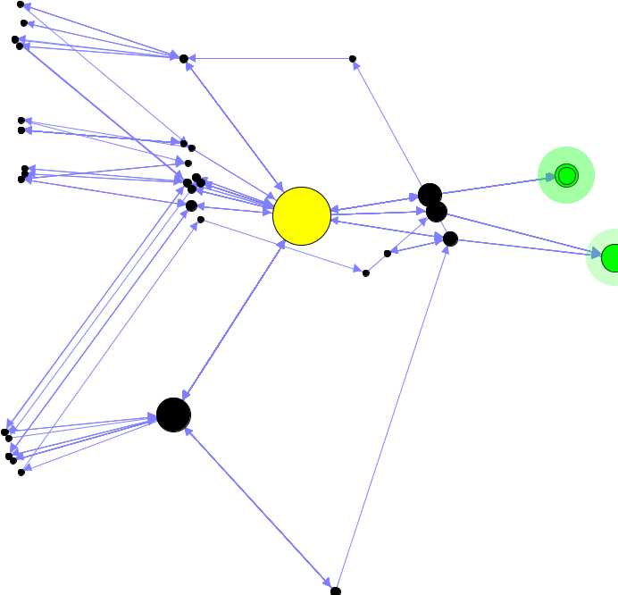
Distance Functions
Action distance
Distance to goal
Combined
Notes:
By combining these two metrics, we can get useful properties of both metrics. The action distance metric keeps states that differ by one or a few moves together, and the goal distance metric causes states to align depending on how far they are from goal states.
Even better, the only information we have used is that there are goal states and the player makes moves to go from one state to another.

Slide 42
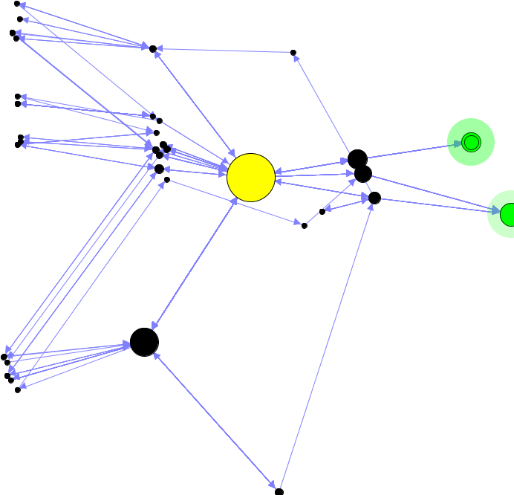
Refraction Distance Function
d (s₁, s₂) = (d_{a} (s₁, s₂) + d_{g} (s₁, s₂)) / 2
Notes:
We can easily think of other distance metrics that will create graphs with other properties, but for a start this one is reasonable. It’s the one we’ll use for the remainder of the talk, with both action and goal distance components weighted equally.

Slide 43
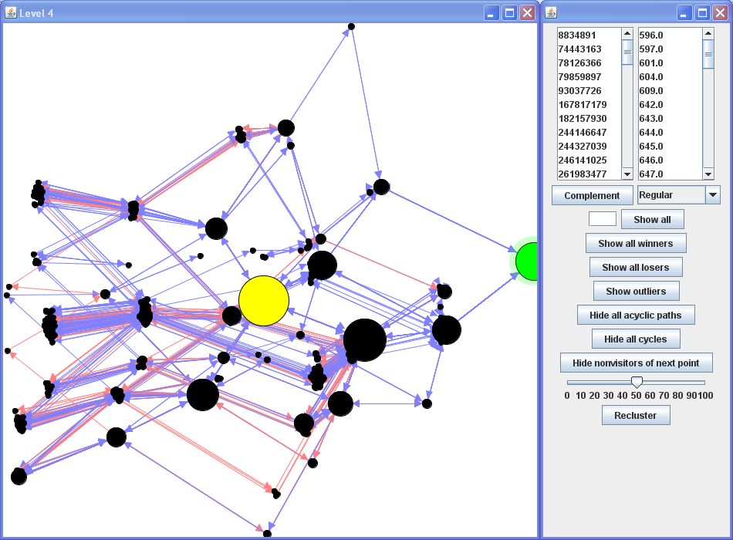
Playtracer Framework
Notes:
We present the Playtracer framework, which is inspired by this idea of visual data mining of aggregated playtrace data. This is an example of output from 30-some players of our games for one of our early game levels. Here, blue arrows are moves made by players who succeeded and red arrows are moves made by players who failed.

Slide 44
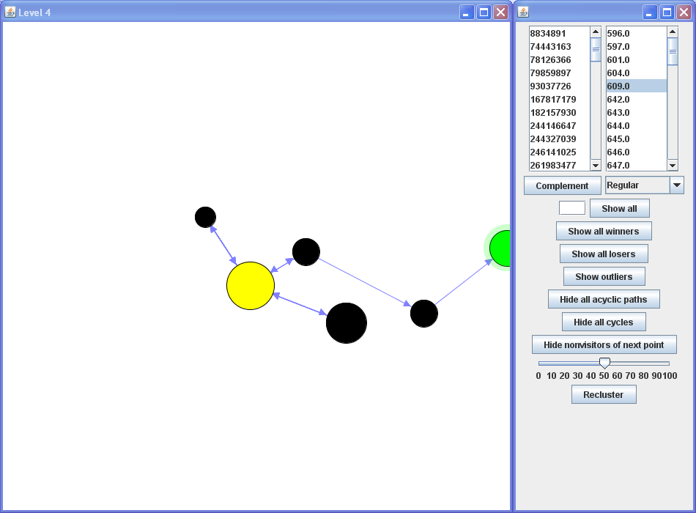
Easy level
Notes:
Our choice of distance metric has some useful consequences. For example, when looking at a single player, it immediately becomes apparent if that player found the level to be relatively easy, as shown by this player’s play path making steady progress towards the goal.

Slide 45
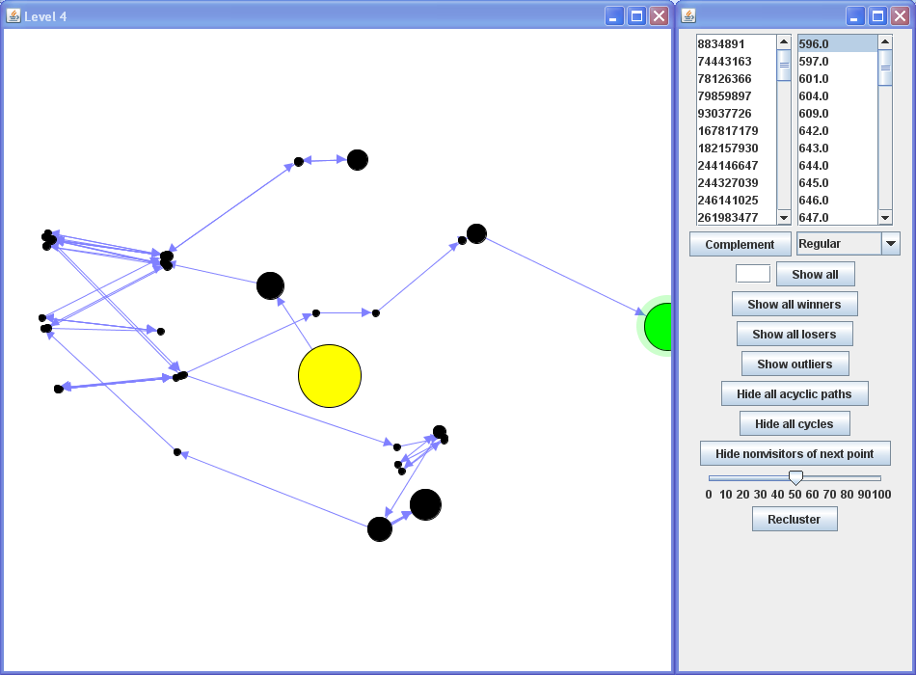
Difficult level
Notes:
We can also identify at a glance if a player had extreme difficulty with a level, indicated by meandering paths that wandered far away from a goal state.

Slide 46
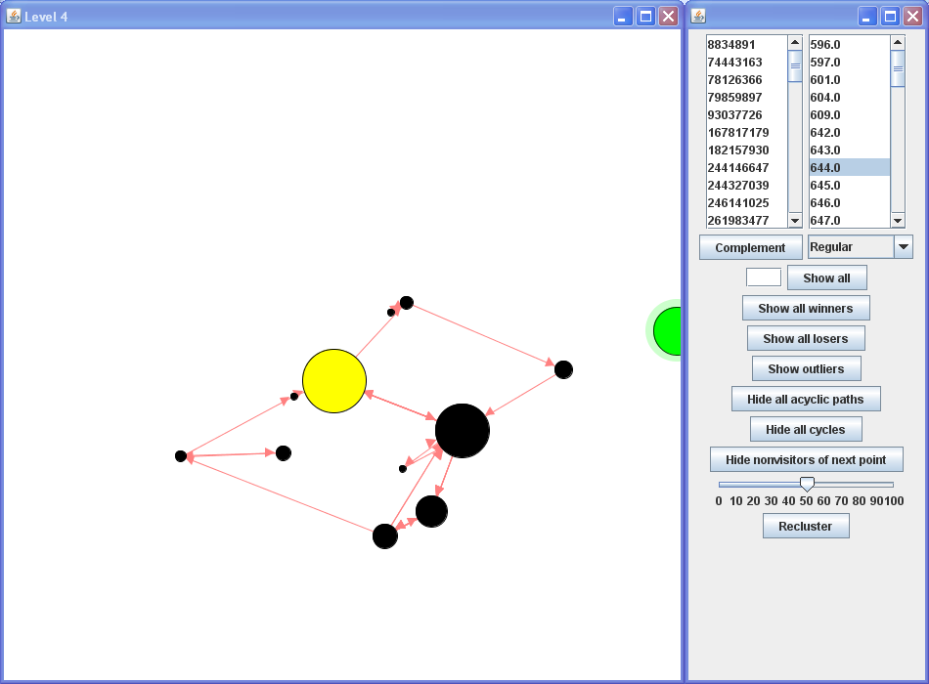
Failure
Notes:
Alternatively, we can look at players who failed to complete a level to identify what caused their problems. Instead of watching several minutes of replay data from the player, we can glance at the graph and see the player was stuck in a loop of states, unable to break out to reach the goal even when only one move away.

Slide 47
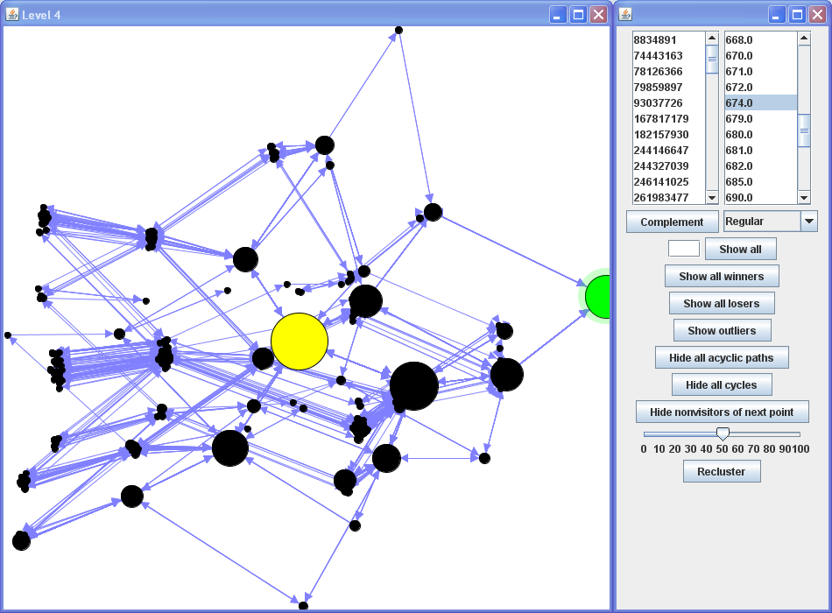
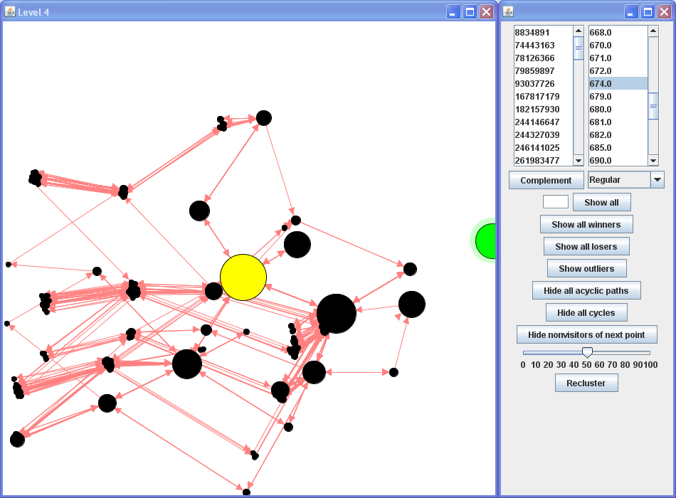
Notes:
Of course, we can also aggregate data. One obvious thing we might want to do is look at the winners and losers of a level and compare them. We can see that both winners and losers found the level to be moderately difficult and explored similar state spaces. Quickly comparing the two, the losers seem to spend less time searching states close to the goal states; perhaps they missed some key insight that would allow them to identify states near the goal as valuable.

Slide 48
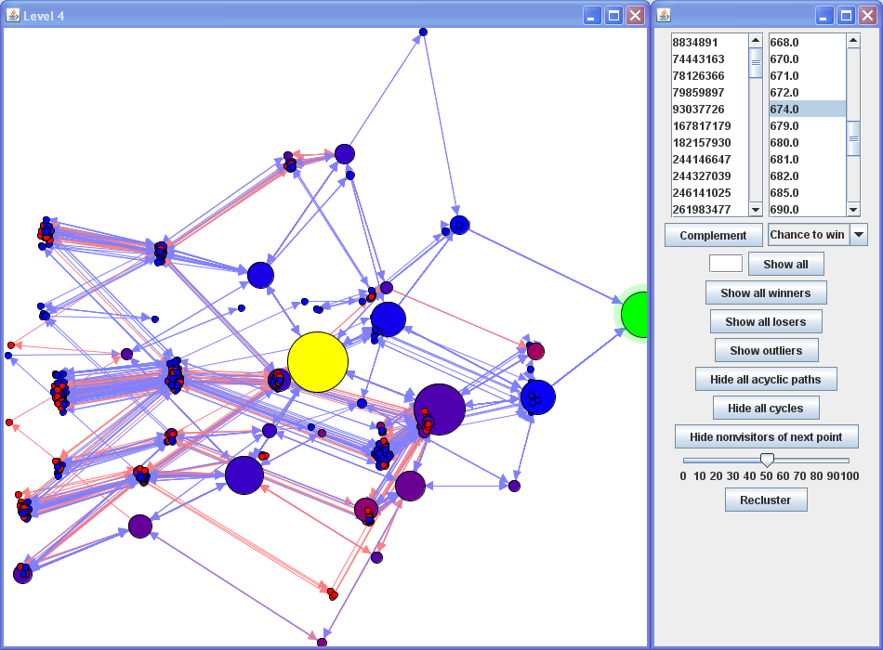
Chance To Win
Notes:
Another useful way to look at the data is to combine the data from winners and losers. For example, we can color states based on the probability that any player that entered that state won or lost. In this visualization, bluish states are those from which players tended to win, while reddish states are those from which players tended to lose.
We would naturally expect states far away from the goal to be colored reddish, and states close to the goal to be colored bluish. With this style of visualization, we can immediately see anomalous states,

Slide 49
Chance To Win
Notes:
such as this high-failure state near the goal. We’ll return to this state and what it means in Refraction later in the evaluation.

Slide 50
Evaluation
Notes:
Using playtracer, the designer can quickly identify gameplay patterns of interest that can be explored further, and from many different angles. In addition, Playtracer can be used on nearly any game, allowing designers to become experts with the system. Now, Erik will show you how we used Playtracer to analyze our Refraction game.
<ERIK> To evaluate the effectiveness of Playtracer, we used it to evaluate gameplay data from Refraction.

Slide 51
Evaluation
35 children from K12 Virtual Academies
Notes:
We had 35 children from K12 Virtual Academies play the game.

Slide 52
Evaluation
35 children from K12 Virtual Academies
Mostly third and fourth-graders
Notes:
They were mostly third and fourth-graders, which is the target age group.

Slide 53
Evaluation
35 children from K12 Virtual Academies
Mostly third and fourth-graders
About 15 levels
Notes:
The children played 15 levels,

Slide 54
Evaluation
35 children from K12 Virtual Academies
Mostly third and fourth-graders
About 15 levels
The game logged all player actions
Notes:
And the game was logging everything the players did and sending the data to us

Slide 55
Analysis
Notes:
Using Playtracer, we were able to identify useful patterns in the data that we are going to group into three general categories.

Slide 56
Analysis
Player confusion
Notes:
Player confusion is where players become confused because they do not understand the game mechanics.

Slide 57
Analysis
Player confusion
Player hypotheses
Notes:
Player hypotheses are the strategies the players try while exploring the state space. These first two both represent lines of thought of the player.

Slide 58
Analysis
Player confusion
Player hypotheses
Design flaws
Notes:
Last, we will talk about design flaws that we uncovered using Playtracer.

Slide 59
Analysis
Player confusion
Player hypotheses
Design flaws
Notes:
We will start with confusion.

Slide 60
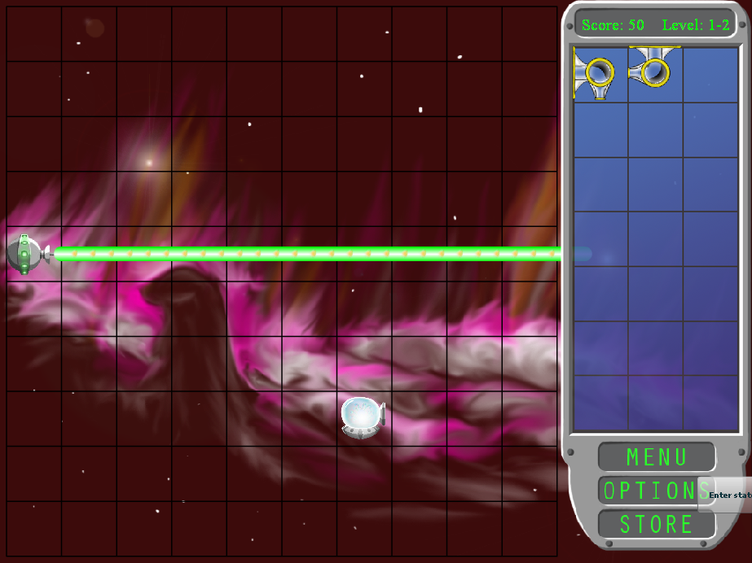
Level 2
Notes:
This is the second level of Refraction. (PAUSE)

Slide 61
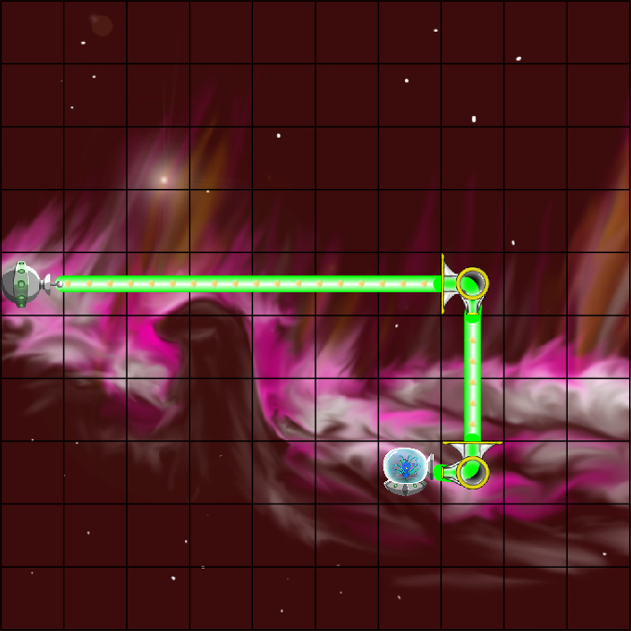
Level 2 Solution
Notes:
It is a tutorial level in which the player must redirect the laser twice ->

Slide 62
Level 2 Solution
Notes:
so that it enters the target spaceship through a funnel on the right-hand side.

Slide 63
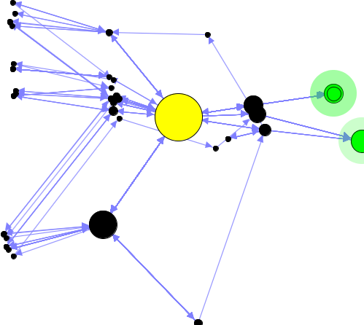
Level 2 Visualization
Notes:
This is the visualization we get from using Playtracer.

Slide 64
Level 2 Visualization
Notes:
One useful method for finding interesting patterns is to look for clusters of states that are further away from the goal than the start state. In this level there are two such clusters, so we drilled down into each of these states to examine what was going on.

Slide 65
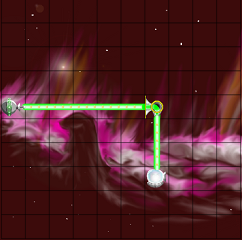
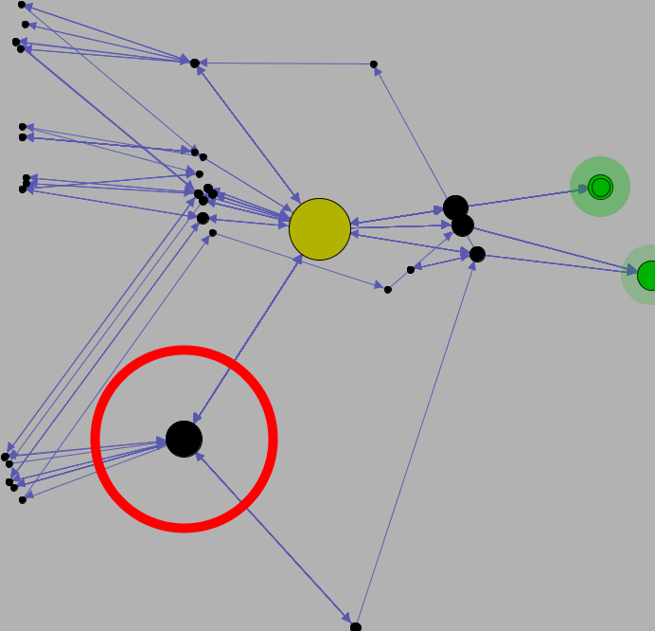
Confusion: Hitting target from wrong side
Notes:
In one popular state that almost half of the players went through, they attempted to hit the target from the top, even though there was a tutorial message here explaining that the lasers must enter the target through the funnel on the right-hand side. Therefore, we could tell that this game mechanic was not immediately clear, perhaps because the tutorial was not clear enough, no one was paying attention to the tutorial, or the art on the piece was unclear.

Slide 66
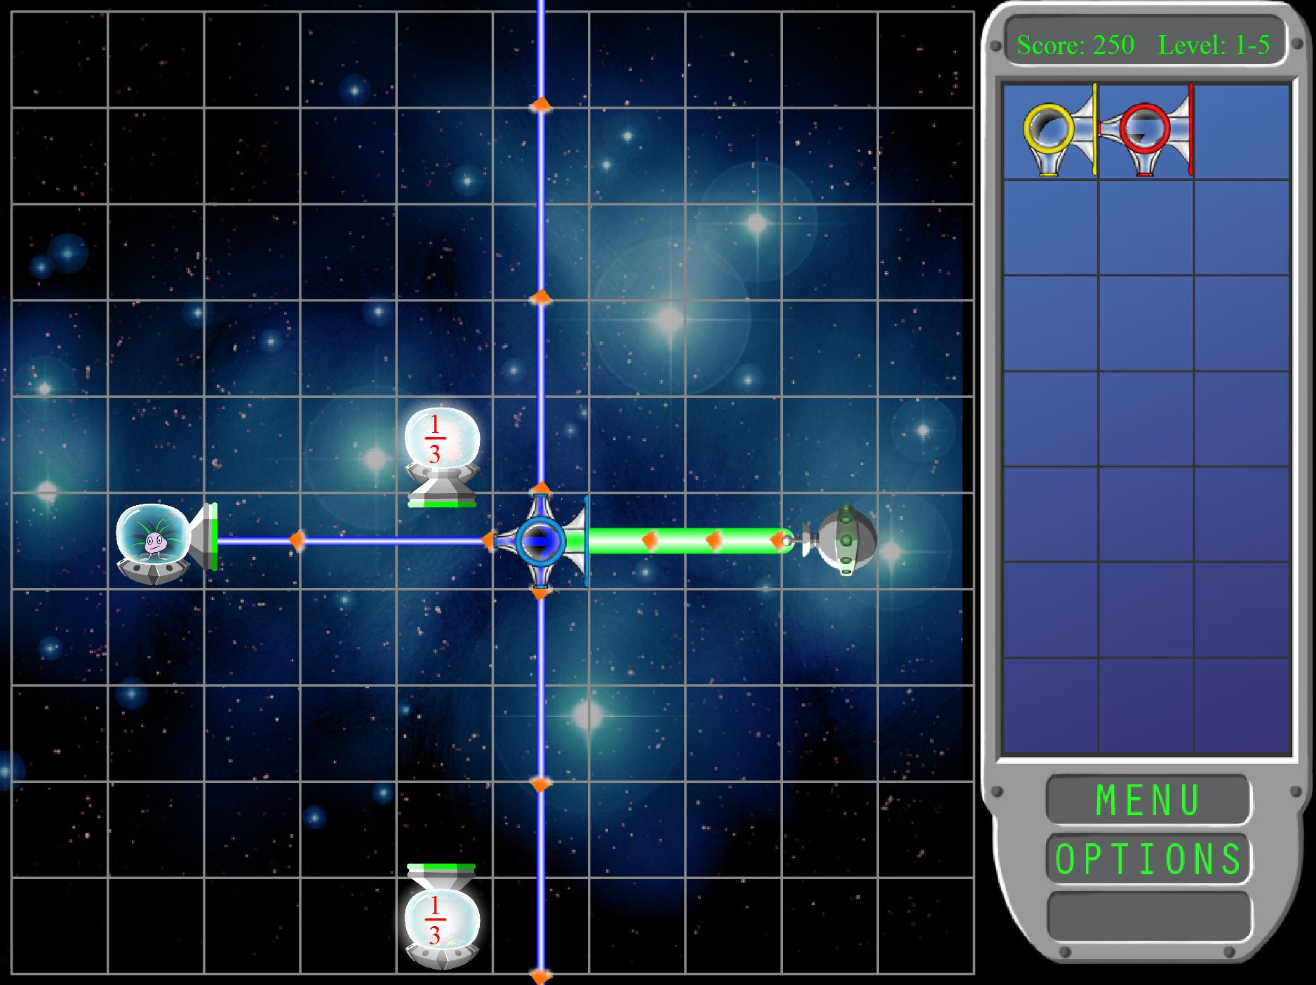
Refinement
Notes:
Since this study we have refined the artwork of the game ->

Slide 67
Refinement
Notes:
so that the entrances to the spaceships are more clear.

Slide 68
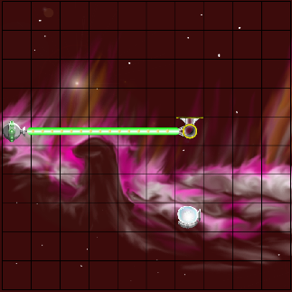
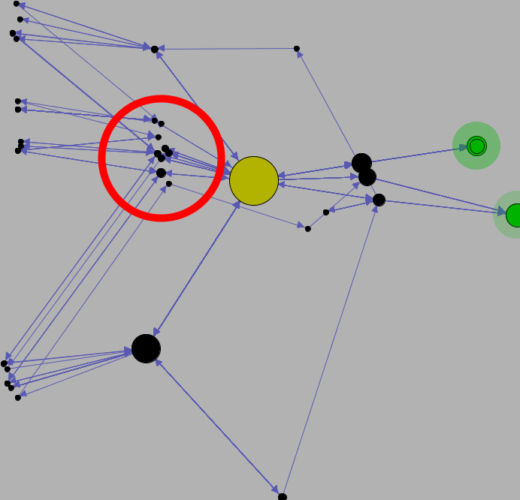
Confusion: Using pieces incorrectly
Notes:
Looking at the states in the cluster on the upper left, we discovered that they were all states where the player was using the pieces incorrectly. We had tried to explain through tutorials that lasers must enter the target ->

Slide 69
Confusion: Using pieces incorrectly
Notes:
through the large funnels, (PAUSE)

Slide 70
Confusion: Using pieces incorrectly
Notes:
and must exit through the small nozzles, and that they cannot be used any other way,

Slide 71
Confusion: Using pieces incorrectly
Notes:
but apparently players were still becoming confused about this mechanic.

Slide 72
Analysis
Player confusion
Player hypotheses
Design flaw
Notes:
Next, I’m going talk a bit about how some of the patterns we found through Playtracer showed how players explored various pathways in the game’s state space, only some of which turned out to be successful. This category is similar to the previous category, but some of the patterns we found here went beyond players just being confused about the game mechanics.

Slide 73
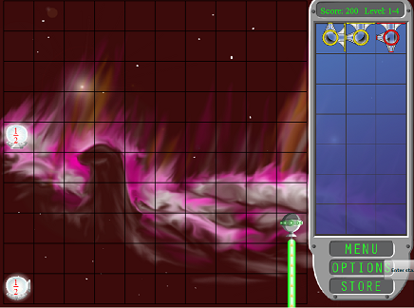
Level 4
Notes:
This used to be the fourth level of Refraction. Here, there are two targets that both want ½ of the laser.

Slide 74
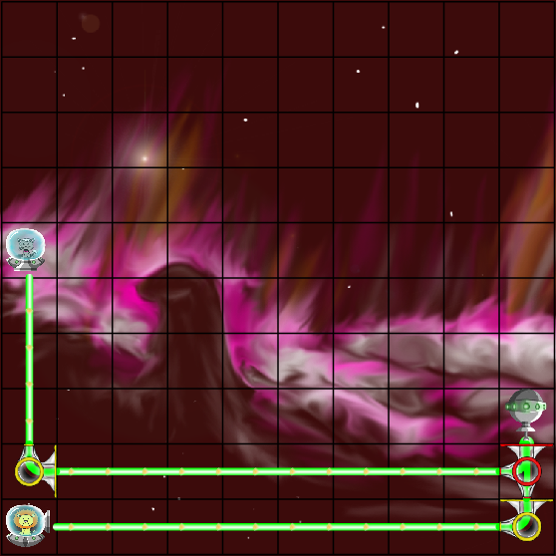
Level 4 Solution
Notes:
In order to satisfy these targets, the player must split the laser in half as shown, and then use bender pieces to redirect the laser to the two targets.

Slide 75
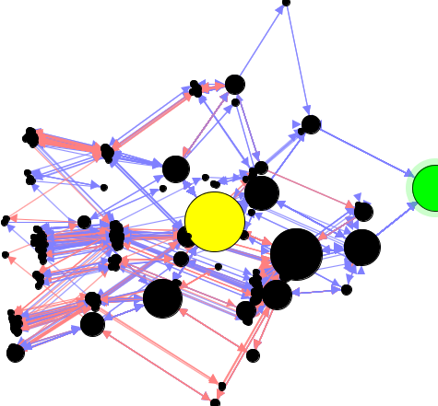
Level 4 Visualization
Notes:
This is the Playtracer visualization of this level. Immediately, we can see that there was a lot more going on here than in the previous level. Several of the players failed and the state space was very cluttered.

Slide 76
Level 4 Visualization
Notes:
In order to look at player strategies, we started looking at big clusters and big states throughout the visualization. We started some of the clusters in the upper left and lower left, which are far away from the goal,

Slide 77
Level 4 Visualization
Notes:
and we also examined the popular cluster in the lower right, which is on the path to the goal.

Slide 78
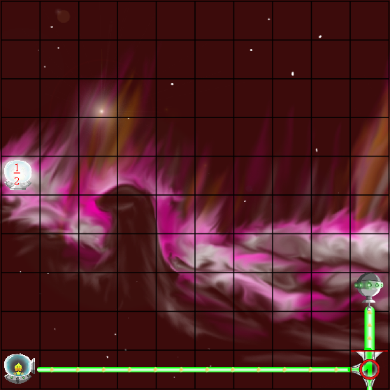
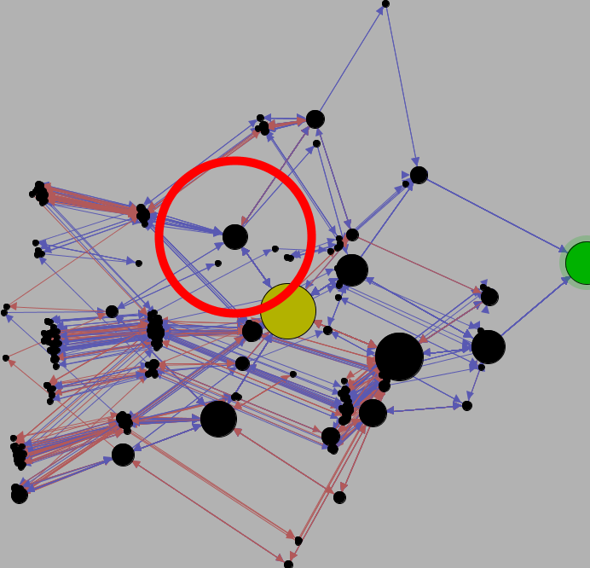
Hypothesis: Satisfy bottom target
Notes:
The cluster in the upper left corresponded to this pattern, where the player has placed the two-splitter in a way such that it can hit the bottom target. However, now the remaining laser is going out of the screen and cannot be redirected back towards the other target. This is kind of the greedy strategy for this level.

Slide 79
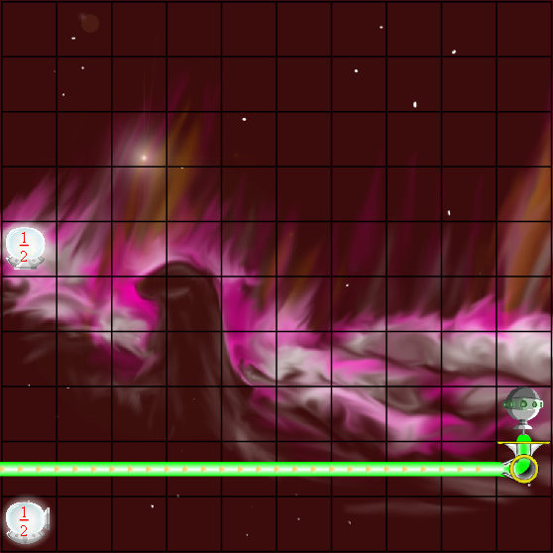
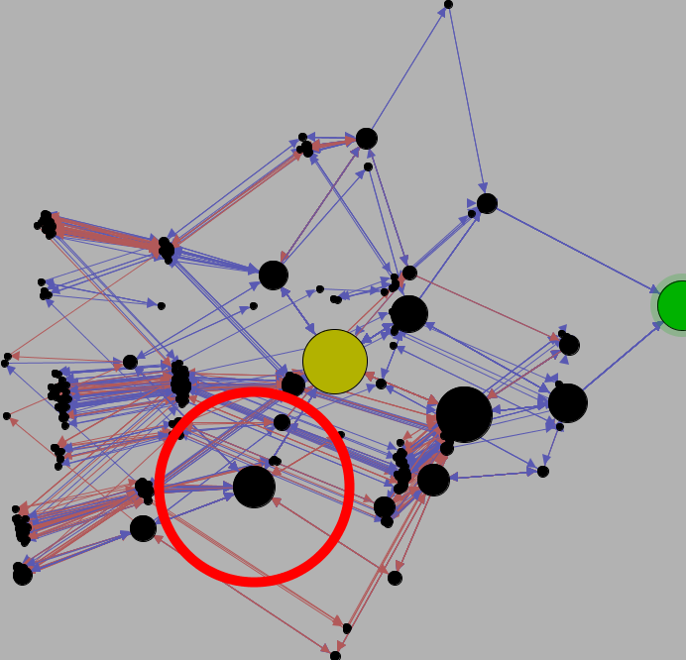
Hypothesis: Get laser near targets
Notes:
In the cluster in the lower left, the player had used a bender to get the laser near the targets. The players may be just trying to get the laser close to the targets, or they may think that they can split the laser once it is over there. However, due to the configuration of pieces in this level, players cannot finish the level if they use this bender piece here.

Slide 80
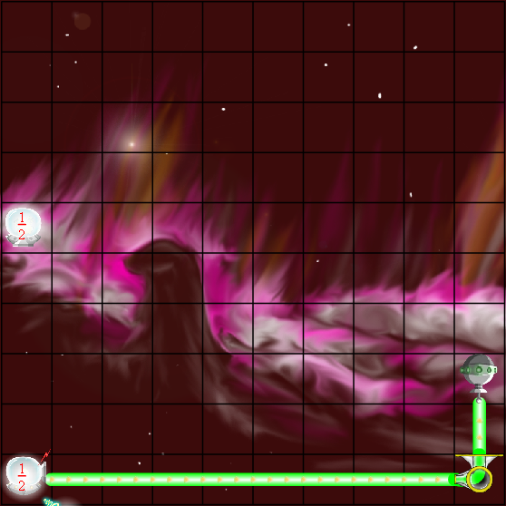
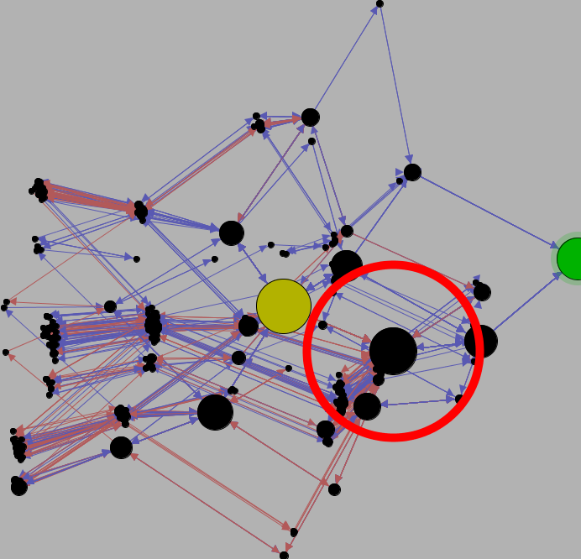
Hypothesis: Overload bottom target
Notes:
Finally, in the cluster in the lower right, which is on the path to the goal, the player has sent all of the laser to the bottom target, overloading it. From here, the player can use the remaining pieces to split the laser and redirect it. So, these three examples show some of the important player strategies in this level.

Slide 81
Analysis
Player confusion
Player hypotheses
Design flaws
Notes:
Finally, I am going to discuss how we used Playtracer to identify a really interesting design flaw in the same level.

Slide 82
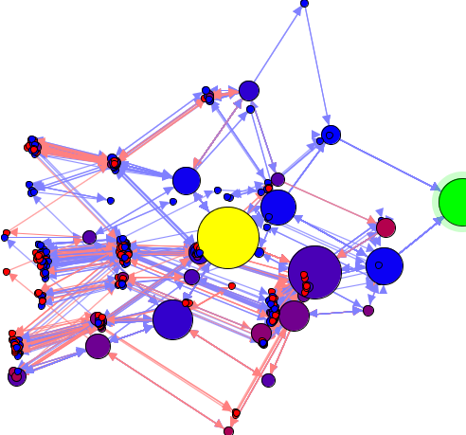
Level 4 Visualization
Notes:
Previously we described how we can color the states based on the probability of winning or losing and look for large red states, particularly large red states that are close to the goal. These states are interesting because many of the players gave up despite being close to the goal.

Slide 83
Level 4 Visualization
Notes:
As we pointed out earlier, in this level, there is such a state that stands out. 11 of 35 players went through this state, and even though it is only a single move away from the goal, no one realized this. Furthermore, of these 11 children, 9 eventually failed.

Slide 84
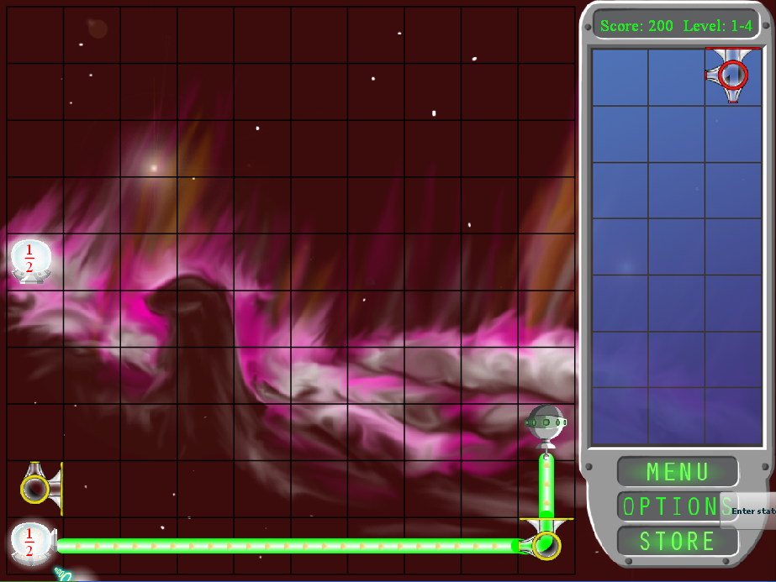
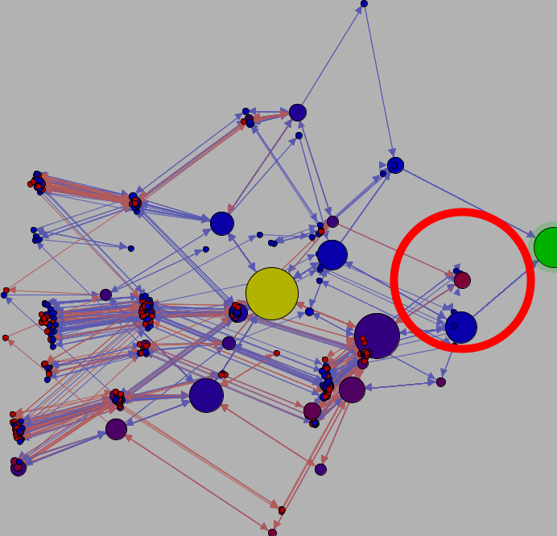
Design flaw: Deadly state
Notes:
When we drilled down into this state, we noticed that the players have put the benders in the right place and all they have to do is use the two-splitter and then they will win. However, nobody did this. There are several reasons why this could be the case. They players may not want to bunch so many pieces into the corner, or they may not be comfortable with splitting and bending lasers yet. Regardless, from the designer’s perspective this behavior was completely unexpected, and Playtracer helped us find this problem quickly.

Slide 85
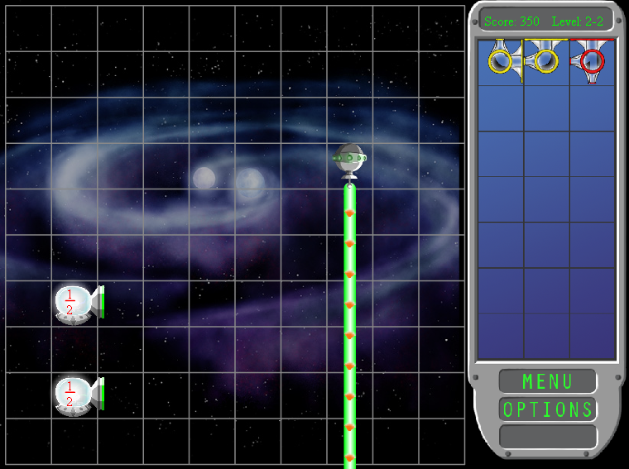
Refinement
Notes:
Based on this information, we fixed this level by moving it later in the progression, reducing the complexity of the laser bending, and making the pieces less bunched together. (PAUSE). These examples all show how Playtracer helped us design a better learning game, as we prepare to send the game to thousands of children through K12 Virtual Academies and gather large amounts of data about how children learn fractions.

Slide 86
Limitations
Difficult to find good distance function
Notes:
I am now going to talk a little bit about the limitations of this method. One problem is that it is often hard to come up with a good distance function. Since our framework gives designers the ability to specify their own distance function, it gives them some flexibility to use distance functions to look at various aspects of the game’s state space. However, this is also a double-edged sword because if the distance function is bad, it will limit the effectiveness of the analysis.

Slide 87
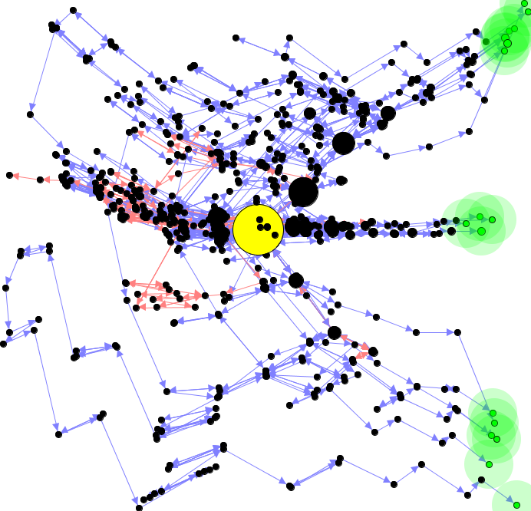
Limitations
Difficult to find good distance function
Notes:
In this particular visualization it looks like there are three distinct goal regions. (PAUSE)

Slide 88


Limitations
Difficult to find good distance function
Notes:
However, when we look at the states in the game, we discover that they are basically the same solution, just with slightly different configurations. It is interesting that Playtracer allows us to see these different solutions, but ideally they should not be so far apart. Improving distance functions is an important area of future work.

Slide 89

Limitations
Large game spaces
Notes:
As the state spaces get larger and larger, they get more cluttered and it can become difficult to figure out what is going on in the visualizations. This can make the analysis more challenging, as in the case of this later level. Also, many games have really complicated state spaces. Therefore, we need a better way of collapsing groups of states together to facilitate visual analysis.

Slide 90
Conclusions
Useful for game analysis
Notes:
Despite these limitations, we have found Playtracer to be very useful as we iteratively refine our game.

Slide 91
Conclusions
Useful for game analysis
We are expanding and refining Playtracer
Notes:
We are now actively working to expand Playtracer and generalize it so that it will help us analyze many of the games that we are planning to build for discovering optimal learning pathways in early mathematics.

Slide 92
Big Open Problems
How to
Notes:
However, we still have a ways to go before we can achieve our goal of being able to find high-level patterns consistently and accurately.

Slide 93
Big Open Problems
How to
  specify distances between game states
Notes:
We have contributed some basic insight into how to specify state distance functions to facilitate visual analysis, but we will need better ways of describing how far apart game states are.

Slide 94
Big Open Problems
How to
  specify distances between game states
  differentiate types of confusion
Notes:
Also, while have shown that we can identify interesting patterns using this approach, we have only scratched the surface of how to use visual data mining consistently to differentiate types of confusion

Slide 95
Big Open Problems
How to
  specify distances between game states
  differentiate types of confusion
  classify player strategies
Notes:
and classify player strategies.

Slide 96
Acknowledgements
Marianne Lee Emma Lynch Justin Irwen Happy Dong Brian Britigan Dennis Doan
François Boucher-Genesse Seth Cooper
Taylor Martin John Bransford
David Niemi Ellen Clark
Funding:
NSF Graduate Fellowship, NSF,
DARPA, Adobe, Intel, Microsoft
Notes:
We would like to thank the people who helped us make Refraction and thanks also to David Niemi and Ellen Clark of K12 who helped us find the playtesters. Thank you.

Slide 97

Cycles
Notes:
What is a cycle in these graphs? A cycle means that the player tried something, then returned to his original state. Therefore, viewing cycles in a playtrace tells us exactly the moves that a player made and decided to take back – a strategy the player decided was no longer worth pursuing.

Slide 98

Acyclic Paths
Notes:
Likewise, what remains after we strip out the cycles of a playtrace? It’s exactly the set moves the player never took back – their chosen solution to the level.

Slide 99

Player Tracking
Notes:
This is the same kid tracked over multiple levels. In levels 3 and 9, the player struggles, but he completes 5 and 8 easily. It turns out that levels 3 and 9 both involve combining splitting and bending, whereas 5 and 8 only require bending or splitting. Combining these two mechanics could be difficult for this child.

