Slide 1
Reconstructing Building Interiors from Images
Yasutaka Furukawa Brian Curless Steven M. Seitz University of Washington, Seattle, USA
Richard Szeliski
Microsoft Research, Redmond, USA

Slide 2
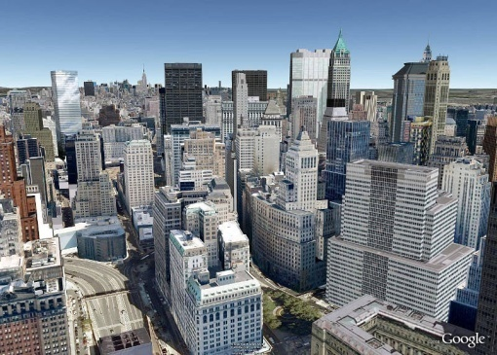
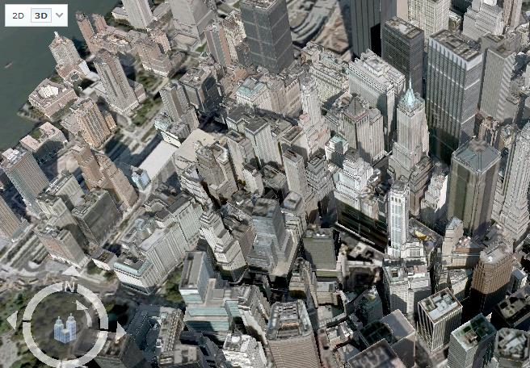
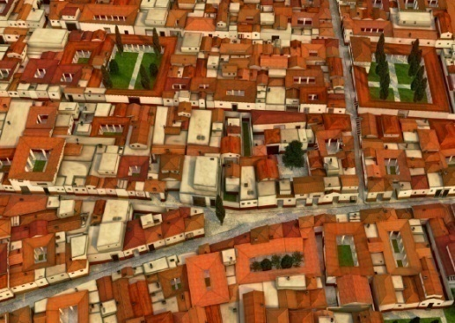
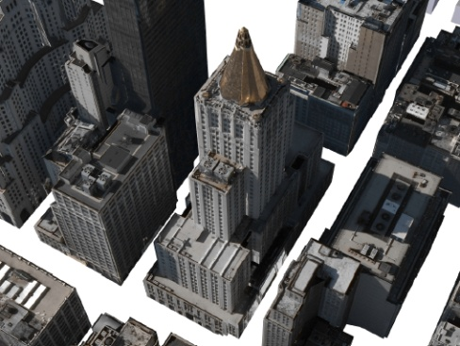
Reconstruction & Visualization of Architectural Scenes
Manual (semi-automatic)
Google Earth & Virtual Earth
Façade [Debevec et al., 1996]
CityEngine [Müller et al., 2006, 2007]
Automatic
Ground-level images [Cornelis et al., 2008, Pollefeys et al., 2008]
Aerial images [Zebedin et al., 2008]
Google Earth
Virtual Earth
Müller et al.
Zebedin et al.

Slide 3
Reconstruction & Visualization of Architectural Scenes
Manual (semi-automatic)
Google Earth & Virtual Earth
Façade [Debevec et al., 1996]
CityEngine [Müller et al., 2006, 2007]
Automatic
Ground-level images [Cornelis et al., 2008, Pollefeys et al., 2008]
Aerial images [Zebedin et al., 2008]
Google Earth
Virtual Earth
Müller et al.
Zebedin et al.

Slide 4
Reconstruction & Visualization of Architectural Scenes
Manual (semi-automatic)
Google Earth & Virtual Earth
Façade [Debevec et al., 1996]
CityEngine [Müller et al., 2006, 2007]
Automatic
Ground-level images [Cornelis et al., 2008, Pollefeys et al., 2008]
Aerial images [Zebedin et al., 2008]
Google Earth
Virtual Earth
Müller et al.
Zebedin et al.

Slide 5
Reconstruction & Visualization of Architectural Scenes
Little attention paid to indoor scenes
Google Earth
Virtual Earth
Müller et al.
Zebedin et al.

Slide 6
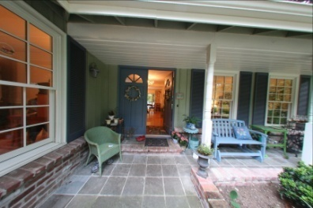
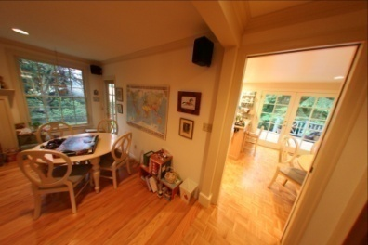
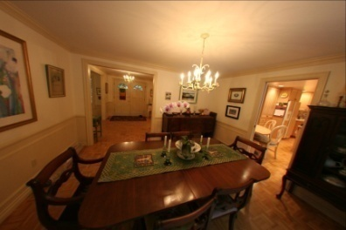
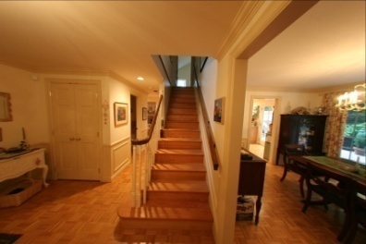
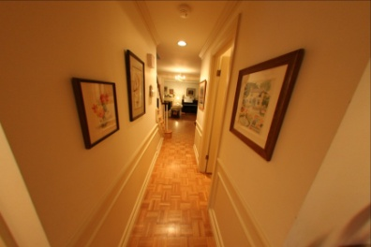
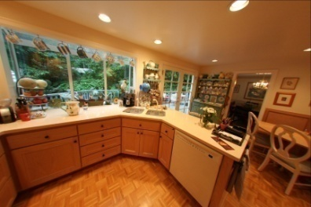
Our Goal
Fully automatic system for indoors/outdoors
Reconstructs a simple 3D model from images
Provides real-time interactive visualization

Slide 7
What are the challenges?

Slide 8
Challenges - Reconstruction
Multi-view stereo (MVS) typically produces a dense model
We want the model to be
Simple for real-time interactive visualization of a large scene (e.g., a whole house)
Accurate for high-quality image-based rendering

Slide 9
Challenges - Reconstruction
Multi-view stereo (MVS) typically produces a dense model
We want the model to be
Simple for real-time interactive visualization of a large scene (e.g., a whole house)
Accurate for high-quality image-based rendering
Simple mode is effective for compelling visualization

Slide 10
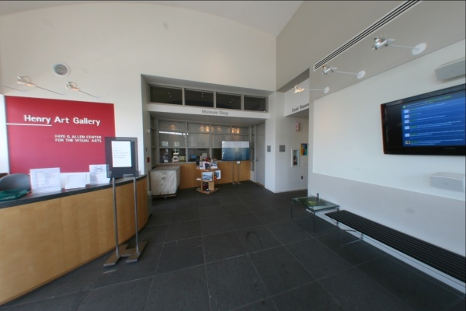
Challenges – Indoor Reconstruction
Texture-poor surfaces
Notes:
Remove bullets and put text behing each photo

Slide 11
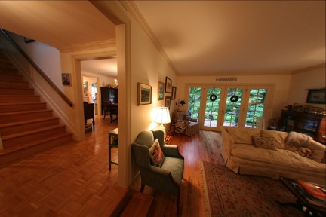
Challenges – Indoor Reconstruction
Texture-poor surfaces
Complicated visibility
Notes:
Remove bullets and put text behing each photo

Slide 12
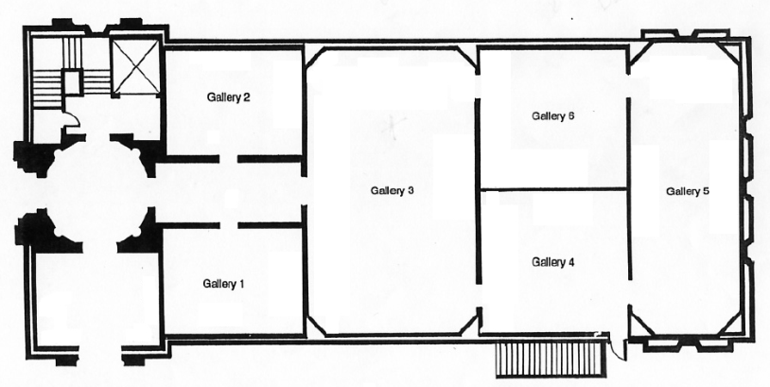
Challenges – Indoor Reconstruction
Texture-poor surfaces
Complicated visibility
Prevalence of thin structures
(doors, walls, tables)
Notes:
Remove bullets and put text behing each photo

Slide 13
Outline
System pipeline (system contribution)
Algorithmic details (technical contribution)
Experimental results
Conclusion and future work

Slide 14
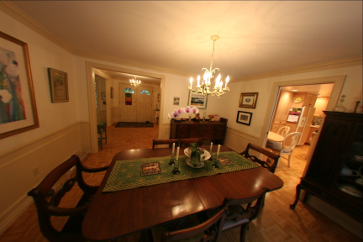
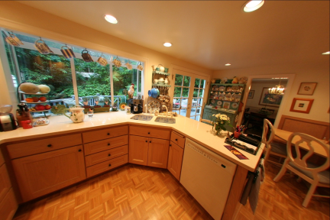
System pipeline
Images
Images

Slide 15
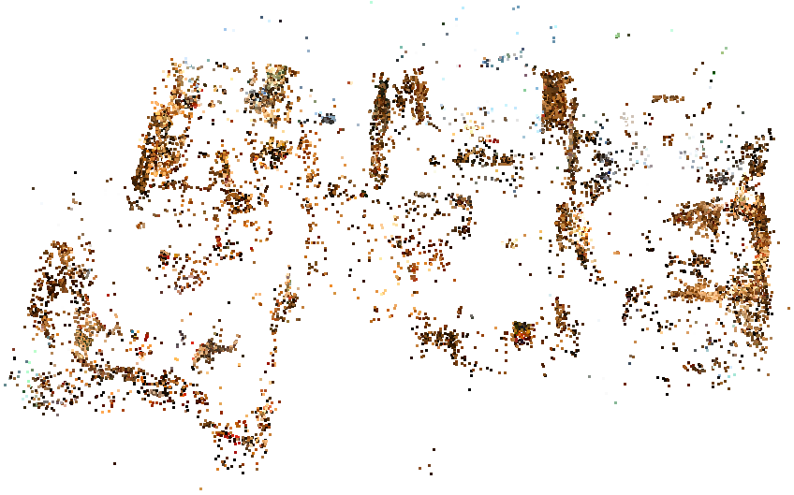
System pipeline
Structure-from-Motion
Bundler by Noah Snavely
Structure from Motion for unordered image collections
http://phototour.cs.washington.edu/bundler/
Images

Slide 16
System pipeline
Images
SFM

Slide 17
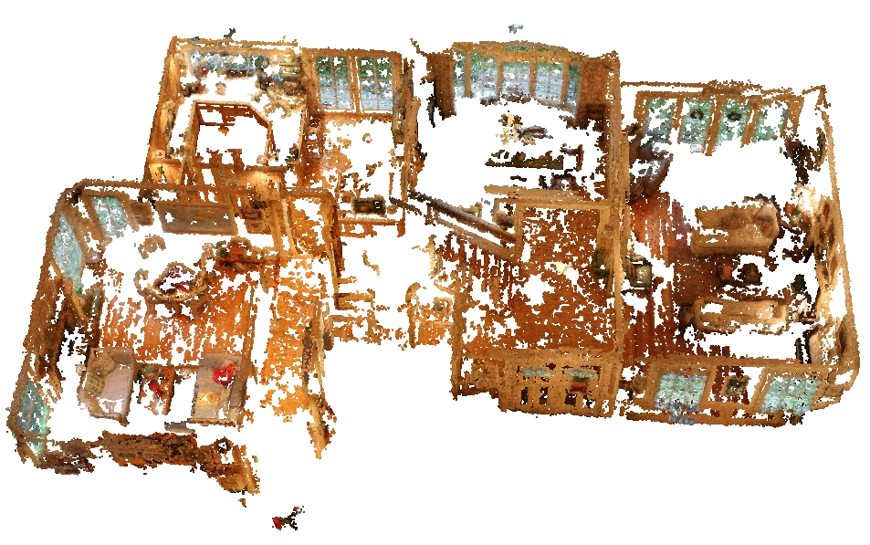
System pipeline
Multi-view Stereo
PMVS by Yasutaka Furukawa and Jean Ponce
Patch-based Multi-View Stereo Software
http://grail.cs.washington.edu/software/pmvs/
Images
SFM

Slide 18
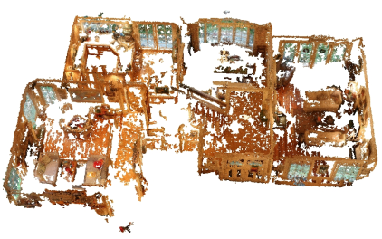
System pipeline
Images
SFM
MVS

Slide 19
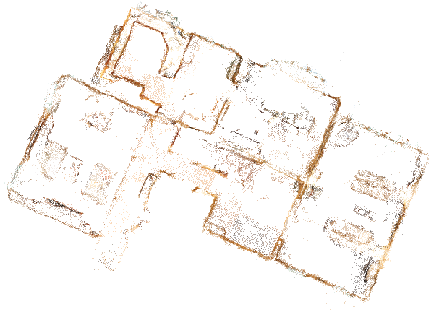
System pipeline
Manhattan-world Stereo
[Furukawa et al., CVPR 2009]
Images
SFM
MVS

Slide 20
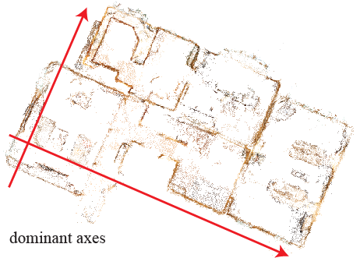
System pipeline
Manhattan-world Stereo
[Furukawa et al., CVPR 2009]
Images
SFM
MVS

Slide 21
System pipeline
Manhattan-world Stereo
[Furukawa et al., CVPR 2009]
Images
SFM
MVS

Slide 22
System pipeline
Manhattan-world Stereo
[Furukawa et al., CVPR 2009]
Images
SFM
MVS

Slide 23
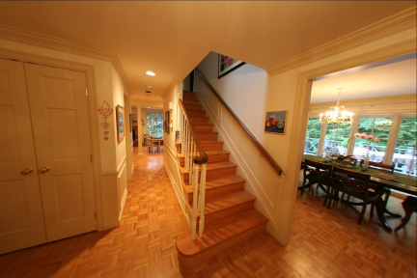
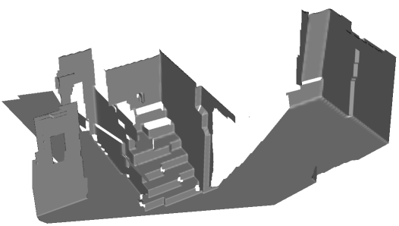
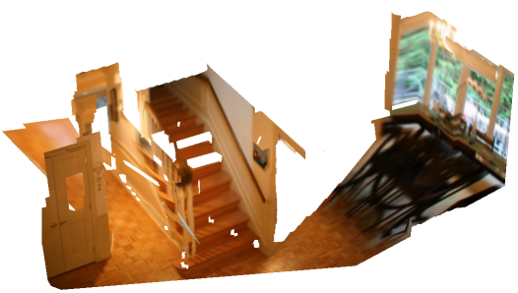
System pipeline
Manhattan-world Stereo
[Furukawa et al., CVPR 2009]
Images
SFM
MVS

Slide 24
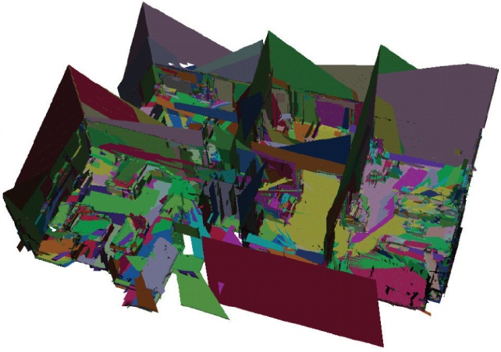
System pipeline
Manhattan-world Stereo
[Furukawa et al., CVPR 2009]
Images
SFM
MVS

Slide 25
System pipeline
Images
SFM
MVS
MWS

Slide 26
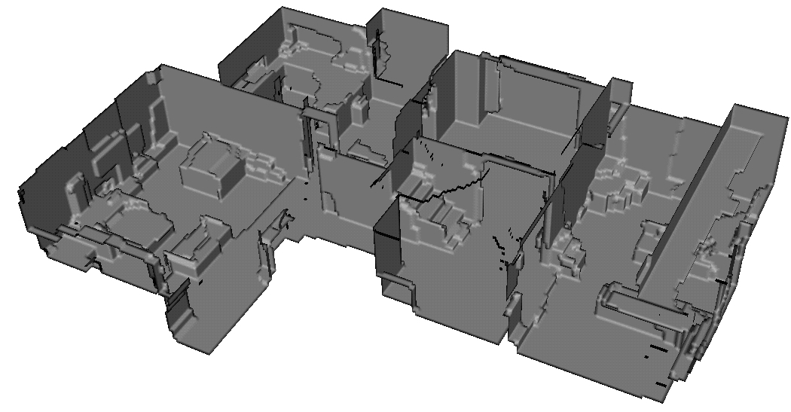
System pipeline
Axis-aligned depth map merging
(our contribution)
Images
SFM
MVS
MWS

Slide 27
System pipeline
Rendering: simple view-dependent texture mapping
Images
SFM
MVS
MWS
Merging

Slide 28
Outline
System pipeline (system contribution)
Algorithmic details (technical contribution)
Experimental results
Conclusion and future work

Slide 29
Axis-aligned Depth-map Merging
Basic framework is similar to volumetric MRF [Vogiatzis 2005, Sinha 2007, Zach 2007, Hernández 2007]
Notes:
Hernandez is the name

Slide 30
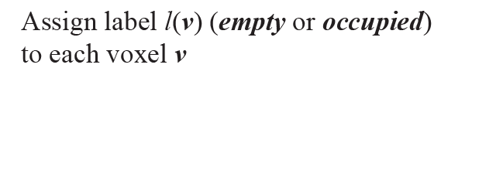
Axis-aligned Depth-map Merging
Basic framework is similar to volumetric MRF [Vogiatzis 2005, Sinha 2007, Zach 2007, Hernández 2007]
Notes:
First explain the algorithm then differences from competing approaches.

Slide 31
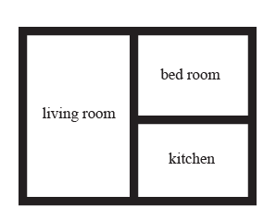
Axis-aligned Depth-map Merging
Basic framework is similar to volumetric MRF [Vogiatzis 2005, Sinha 2007, Zach 2007, Hernández 2007]
Notes:
First explain the algorithm then differences from competing approaches.

Slide 32
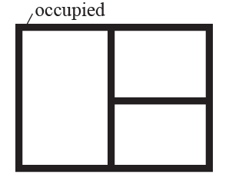
Axis-aligned Depth-map Merging
Basic framework is similar to volumetric MRF [Vogiatzis 2005, Sinha 2007, Zach 2007, Hernández 2007]
Notes:
First explain the algorithm then differences from competing approaches.

Slide 33
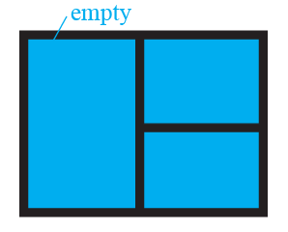
Axis-aligned Depth-map Merging
Basic framework is similar to volumetric MRF [Vogiatzis 2005, Sinha 2007, Zach 2007, Hernández 2007]
Notes:
First explain the algorithm then differences from competing approaches.

Slide 34
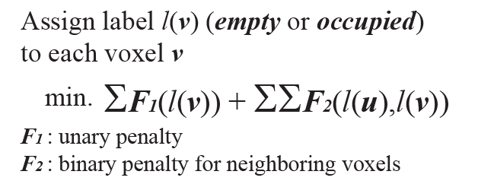
Axis-aligned Depth-map Merging
Basic framework is similar to volumetric MRF [Vogiatzis 2005, Sinha 2007, Zach 2007, Hernández 2007]
Notes:
First explain the algorithm then differences from competing approaches.

Slide 35
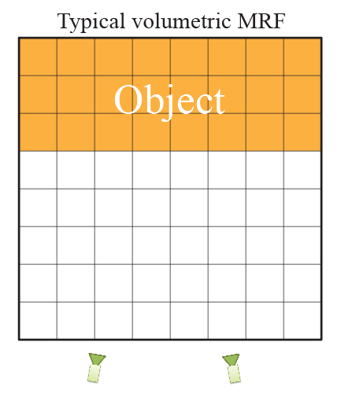
Key Feature 1 - Penalty terms

Slide 36
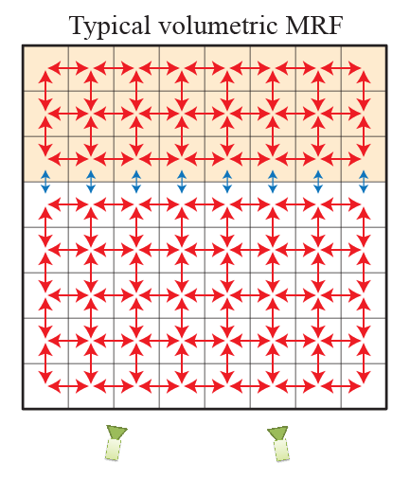
Key Feature 1 - Penalty terms
Binary penalty
Binary encodes smoothness & data

Slide 37
Key Feature 1 - Penalty terms
Binary penalty
Binary encodes smoothness & data Unary is often constant (inflation)

Slide 38
Key Feature 1 - Penalty terms
Weak regularization at interesting places
Focus on a dense model
Binary penalty
Binary encodes smoothness & data Unary is often constant (inflation)

Slide 39
Key Feature 1 - Penalty terms
Weak regularization at interesting places
Focus on a dense model
We want a simple model
Binary penalty
Binary encodes smoothness & data Unary is often constant (inflation)

Slide 40
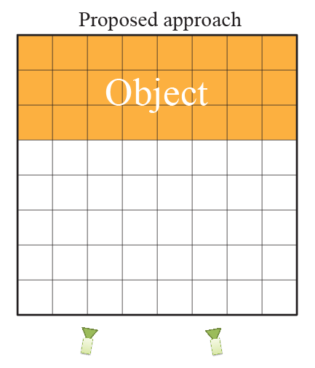
Key Feature 1 - Penalty terms
Binary penalty
Binary encodes smoothness & data
Unary is often constant (inflation)

Slide 41
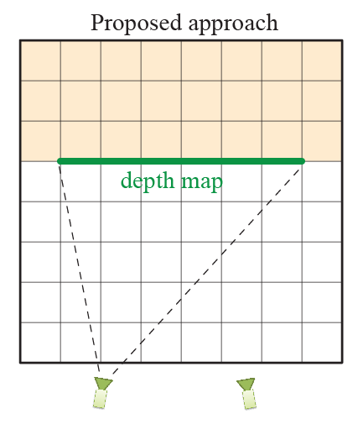
Key Feature 1 - Penalty terms
Binary penalty
Binary encodes smoothness & data
Unary is often constant (inflation)

Slide 42
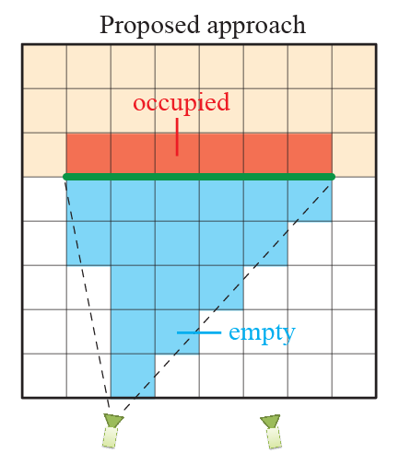
Key Feature 1 - Penalty terms
Binary penalty
Binary encodes smoothness & data
Unary is often constant (inflation)
Unary encodes data

Slide 43
Key Feature 1 - Penalty terms
Binary penalty
Binary encodes smoothness & data
Unary is often constant (inflation)
Binary is smoothness
Unary encodes data
Notes:
Binary is smoothness defined as neighboring voxels having the same label

Slide 44
Key Feature 1 - Penalty terms
Binary penalty
Regularization becomes weak →Dense 3D model
Regularization is data-independent
→Simpler 3D model

Slide 45
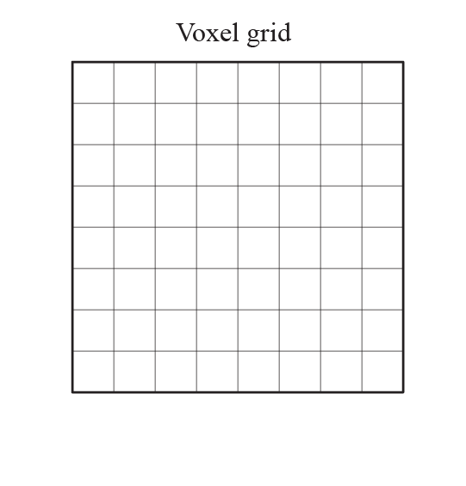
Axis-aligned Depth-map Merging
Align voxel grid with the dominant axes
Notes:
Put here how typical approaches do, and why they do not work
Talk about 4d neighborhood,
Put texts at the bottom of the figures

Slide 46
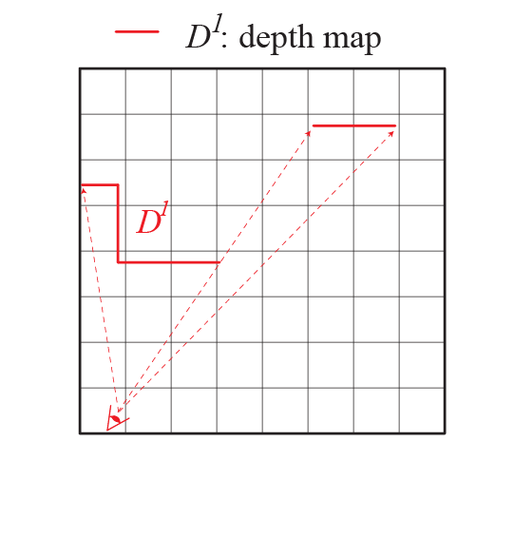
Axis-aligned Depth-map Merging
Align voxel grid with the dominant axes
Data term (unary)
Notes:
Put here how typical approaches do, and why they do not work
Talk about 4d neighborhood,
Put texts at the bottom of the figures

Slide 47
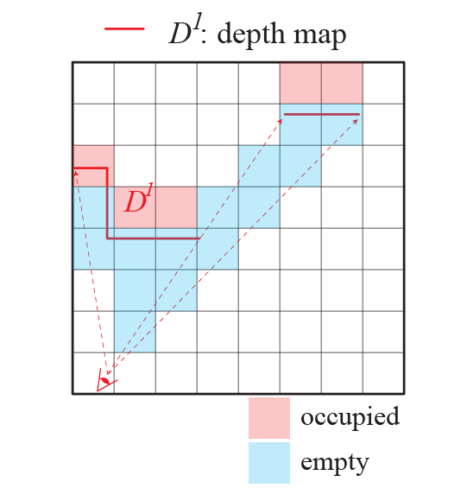
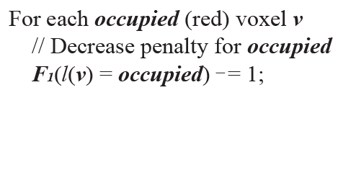
Axis-aligned Depth-map Merging
Align voxel grid with the dominant axes
Data term (unary)
Notes:
Put here how typical approaches do, and why they do not work
Talk about 4d neighborhood,
Put texts at the bottom of the figures

Slide 48
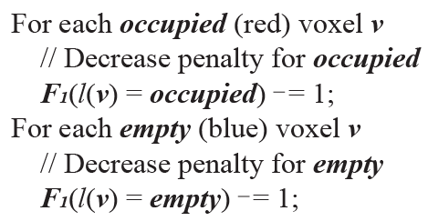
Axis-aligned Depth-map Merging
Align voxel grid with the dominant axes
Data term (unary)
Notes:
Put here how typical approaches do, and why they do not work
Talk about 4d neighborhood,
Put texts at the bottom of the figures

Slide 49
Axis-aligned Depth-map Merging
Align voxel grid with the dominant axes
Data term (unary)
Smoothness (binary)
Notes:
Put here how typical approaches do, and why they do not work
Talk about 4d neighborhood,
Put texts at the bottom of the figures

Slide 50
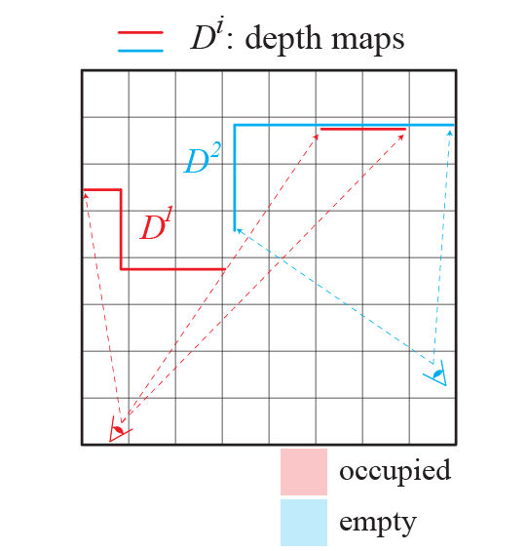
Axis-aligned Depth-map Merging
Align voxel grid with the dominant axes
Data term (unary)
Smoothness (binary)
Notes:
Put here how typical approaches do, and why they do not work
Talk about 4d neighborhood,
Put texts at the bottom of the figures

Slide 51
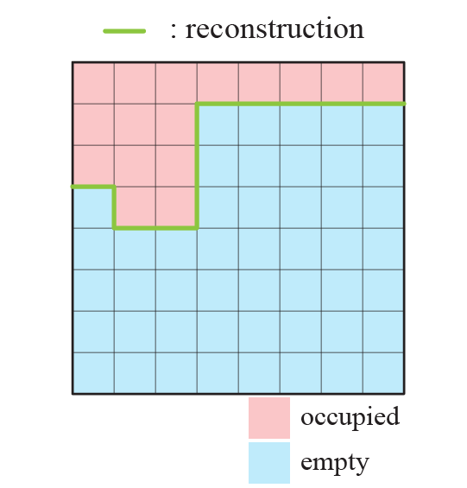
Axis-aligned Depth-map Merging
Align voxel grid with the dominant axes
Data term (unary)
Smoothness (binary)
Graph-cuts
Notes:
Put here how typical approaches do, and why they do not work
Talk about 4d neighborhood,
Put texts at the bottom of the figures

Slide 52
Key Feature 2 – Regularization
For large scenes, data info are not complete

Slide 53
Key Feature 2 – Regularization
For large scenes, data info are not complete
Typical volumetric MRFs bias to general minimal surface [Boykov and Kolmogorov, 2003]
We bias to piece-wise planar axis-aligned for architectural scenes

Slide 54
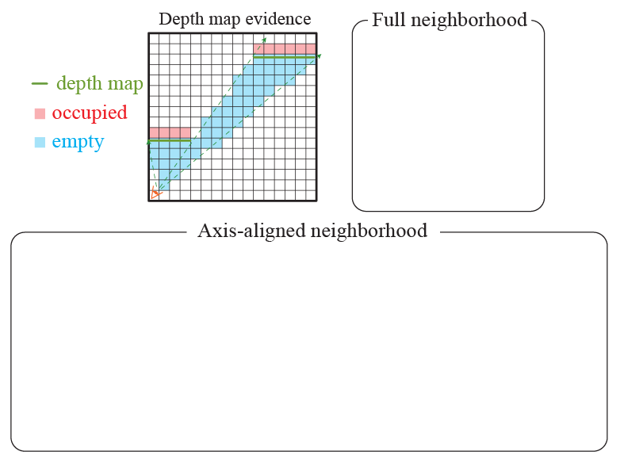
Key Feature 2 – Regularization

Slide 55
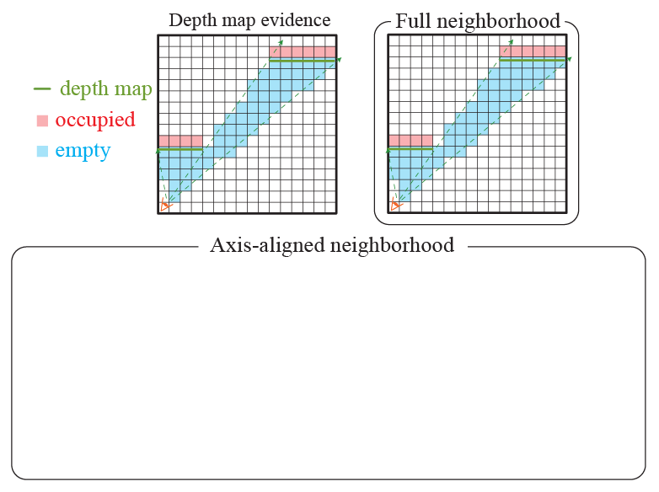
Key Feature 2 – Regularization

Slide 56
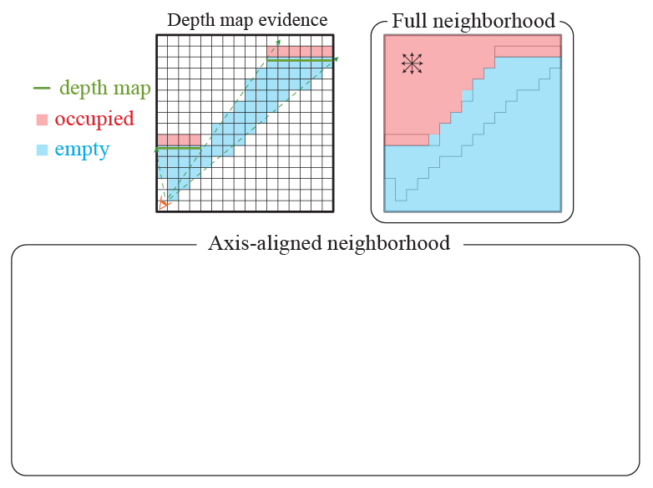
Key Feature 2 – Regularization

Slide 57
Key Feature 2 – Regularization

Slide 58
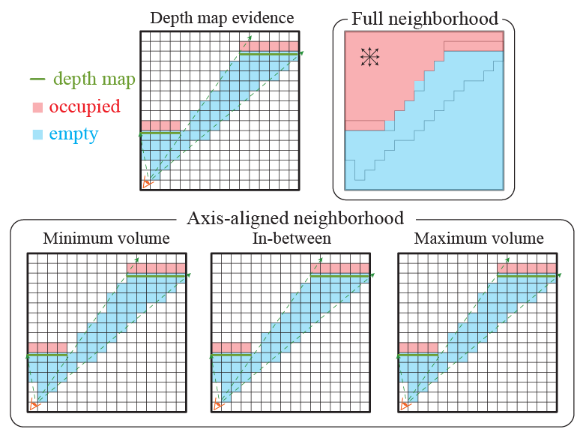
Key Feature 2 – Regularization

Slide 59
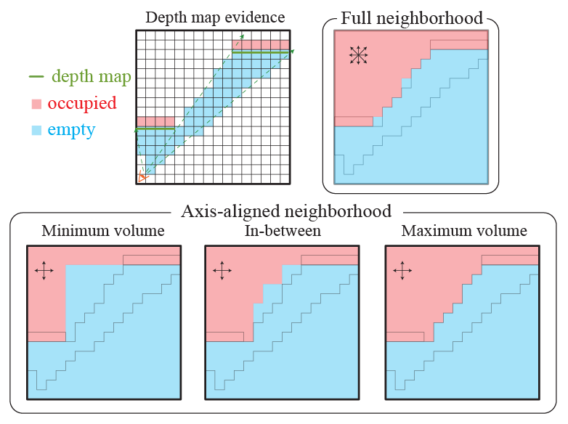
Key Feature 2 – Regularization
Same energy (ambiguous)

Slide 60
Key Feature 2 – Regularization
Same energy (ambiguous)
Data penalty: 0

Slide 61
Key Feature 2 – Regularization
Same energy (ambiguous)
Data penalty: 0 Smoothness penalty:
Data penalty: 0 Smoothness penalty: 24
Data penalty: 0

Slide 62
Key Feature 2 – Regularization
shrinkage

Slide 63
Key Feature 2 – Regularization
Axis-aligned neighborhood + Potts model
Ambiguous
Break ties with the minimum-volume solution
Piece-wise planar axis-aligned model

Slide 64
Key Feature 3 – Sub-voxel accuracy

Slide 65
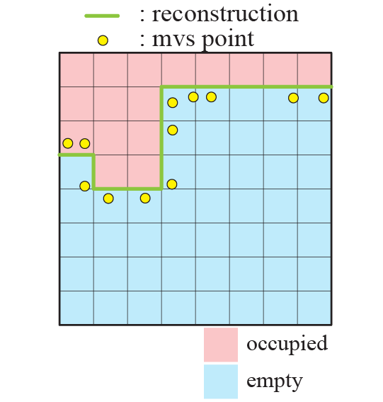
Key Feature 3 – Sub-voxel accuracy

Slide 66
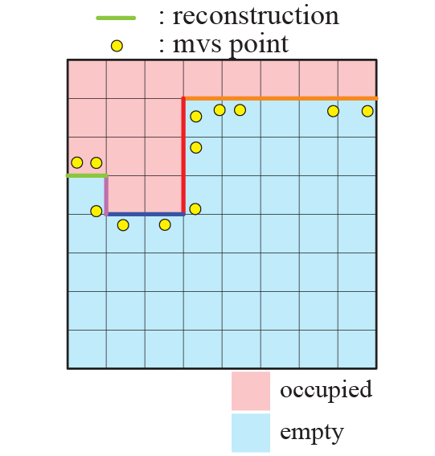
Key Feature 3 – Sub-voxel accuracy

Slide 67
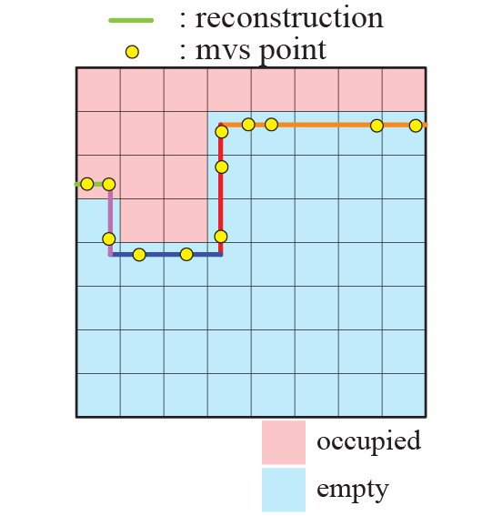
Key Feature 3 – Sub-voxel accuracy

Slide 68
Summary of Depth-map Merging
For a simple and axis-aligned model
Explicit regularization in binary
Axis-aligned neighborhood system & minimum-volume solution
For an accurate model
Sub-voxel refinement

Slide 69
Outline
System pipeline (system contribution)
Algorithmic details (technical contribution)
Experimental results
Conclusion and future work

Slide 70
Kitchen - 22 images
1364 triangles
hall - 97 images
3344 triangles
house - 148 images
8196 triangles
gallery - 492 images
8302 triangles

Slide 72
Demo

Slide 73
Running Time
Running time of 4 steps [min]
 | Kitchen (22 images) | Hall (97 images) | House (148 images) | gallery (492 images)
SFM | 13 | 76 | 92 | 716
MVS | 38 | 158 | 147 | 130
MWS | 39.6 | 281.3 | 843.6 | 5677.4
Merging | 0.4 | 0.4 | 3.6 | 22.4
Notes:
We only show final 3D models here and please refer to the paper for more details.

Slide 74
Conclusion & Future Work
Conclusion
Fully automated 3D reconstruction/visualization system for architectural scenes
Novel depth-map merging to produce piece-wise planar axis-aligned model with sub-voxel accuracy
Future work
Relax Manhattan-world assumption
Larger scenes (e.g., a whole building)

Slide 75
For More Details
Please refer to the paper and
our project website
http://grail.cs.washington.edu/projects/interior/
3D viewer and dataset available

Slide 76
For More Details
Come to a demo session this afternoon (1:15pm)

Slide 77
For More Details
Come to a demo session this afternoon (1:15pm)
Open-source SFM and MVS software
Bundler
Noah Snavely http://phototour.cs.washington.edu/bundler
PMVS Version2
Yasutaka Furukawa and Jean Ponce
http://grail.cs.washington.edu/software/pmvs

Slide 78
Acknowledgements
Sameer Agarwal and Noah Snavely for support on SFM and discussion
Funding sources
National Science Foundation grant IIS-811878
SPAWAR
The Office of Naval Research
The University of Washington Animation Research Labs
Datasets
Christian Laforte and Feeling Software for Kitchen
Eric Carson and Henry Art Gallery for gallery

Slide 79
Any Questions?
Images
SFM
MVS
MWS
Merging

